Slide 1
2023 1학기 FR 프로젝트
Portfolio Optimization
35기: 류제현 박민규 황인준
36기: 이대원 장은경 전호연
PPT: 류제현

Slide 2
Contents
Ⅰ. Project Description
Ⅱ. Data
Ⅲ. Estimation Issues
Ⅳ. Empirical Result

Slide 3
Ⅰ. Project Description

Slide 4
Ⅰ. Project Description : Blueprint
∙ 포트폴리오 최적화 (Portfolio Optimization)
자산 배분(Asset Allocation) / Long-Only Portfolio
1. Define Object Function
2. Estimate Expected Return and Covariance Matrix
3. Find Weight Vector(Optimal Solutions) that Maximize or Minimize the Object Function
∙ 최적화 방법 (Optimization Method) : How to Find Optimal Solution?
1. SLSQP
2. Deep Learning

Slide 5
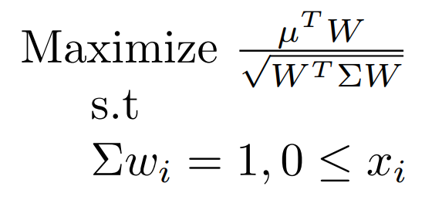
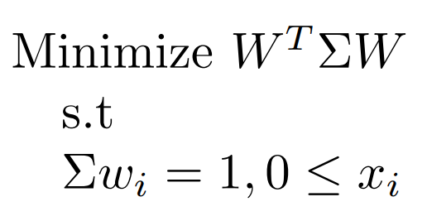
Ⅰ. Project Description : Define Object Function
Target: Maximize Sharpe Ratio
Target: Minimize Variance

Slide 6
Ⅰ. Project Description : Algorithm
∙ SLSQP
∙ Optimization Under Constraint and Bounds / Approximate Using a Second Order Equation
∙ Assets Universe : S&P500 / ETF
∙ Sharpe Ratio Maximization / Variance Minimization
∙ Deep Learning
∙ LSTM: Long Short Term Memory
∙ Assets Universe : ETF
∙ Sharpe Ratio Maximization

Slide 7
Ⅱ. Data

Slide 8
Ⅱ. Data : S&P500
Vender
∙ Daily Security Price: The Center for Research in Security Prices
∙ Daily S&P500 Constitute: The Center for Research in Security Prices
Description
∙ Sample Period: 2007.01.03 - 2022.12.30
∙ The Number of Company: Min 498 (2008-09-11) - Max 508 (2016-11-01)
Preprocessing
∙ Prevention of Survivorship Bias: Using Daily S&P500 Constitute Data
∙ Using Adjusted Close Price: To Deal with Merger and Acquisition, Stock Split

Slide 9
Ⅱ. Data : ETF
Vender
∙ Daily ETF Price: The Center for Research in Security Prices
Description
∙ Sample Period: 2007.05.31 - 2023.05.01
∙ The Number of ETF: 11
Stock : SPY, IJS, VWO
Bond : TLT, SHY, BIL
Gold : GLD
Commodity : GSG
Real Estate : VNQ
Agriculture : DBA

Slide 10
Ⅲ. Estimation Issues

Slide 11
Ⅲ. Estimation Issues : Problems of Estimate Covariance Matrix
∙ Problem 1. Noisy Estimates
Estimation Issues Arise
∙ The Length of Time Series < The Number of Asset
∙ J. Bun, J. P. Bouchaud, and M. Potters (2017)
“ The errors in the covariance matrix estimates further propagate to portfolio optimization problems, leading to poor out-of-sample performance of portfolios optimized using noisy estimates ”
∙Problem 2. Singular Covariance Matrix
∙ When the Market Crash High Correlation of Risky Assets
∙ S. Page and R.A. Panariello (2018)
“ Conditional correlations reveal that during market crises, diversification across risk assets almost completely disappears ”

Slide 12
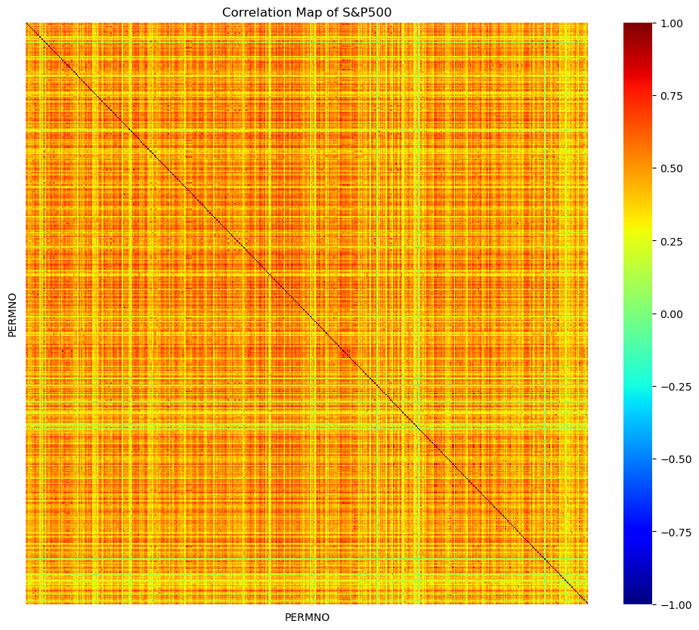
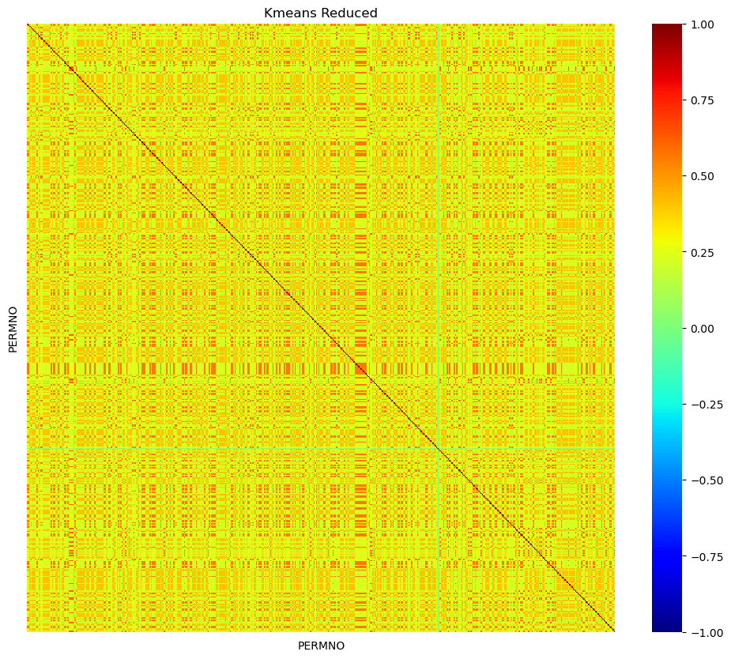
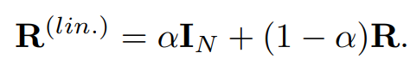
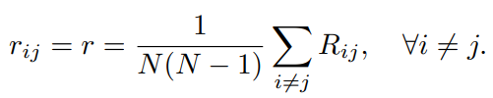
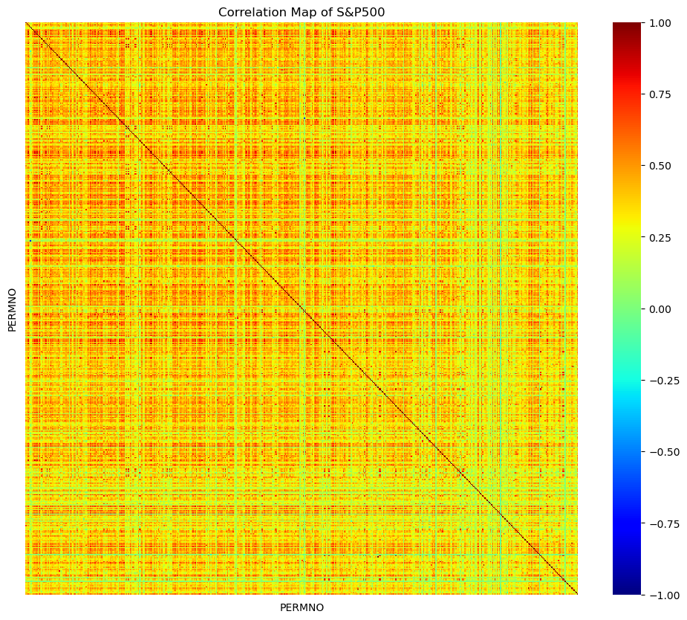
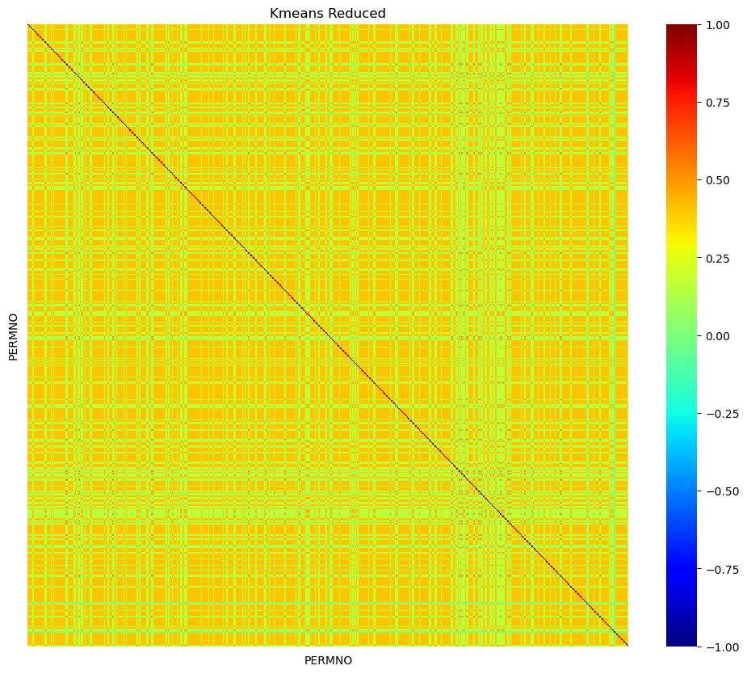
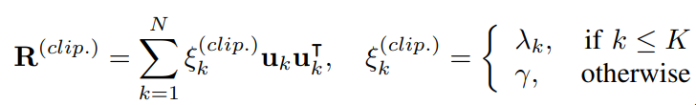
Ⅲ. Estimation Issues - Problem 1. Noisy Estimates
∙ How to deal with noisy estimates? Use shrinkage method!
Estimated Correlation Matrix
Shrinkage Correlation Matrix
Methodology
∙ Basic Linear Shrinkage
∙ Constant Shrinkage
∙Eigen Value Clipping

Slide 13
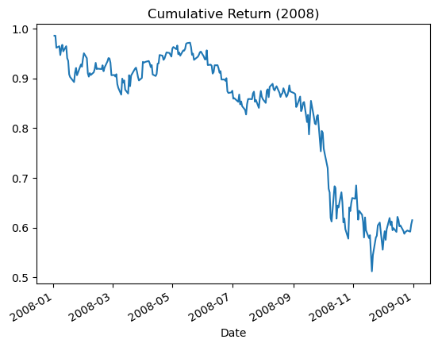
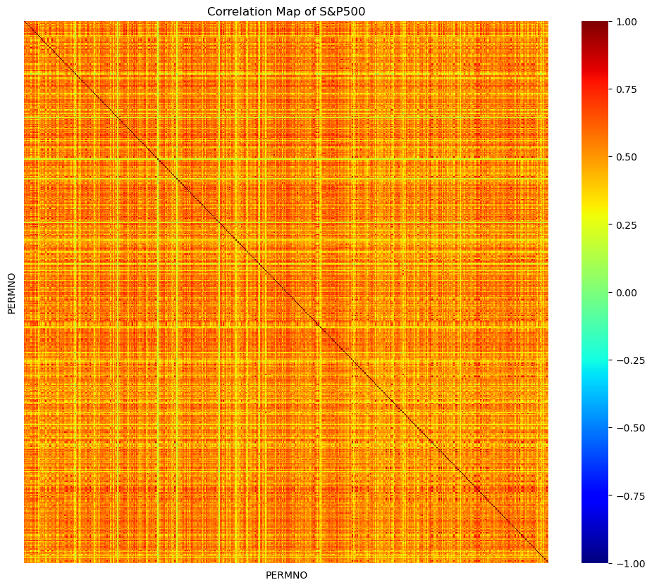
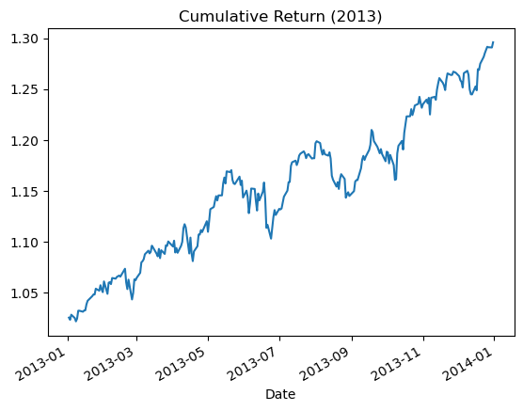
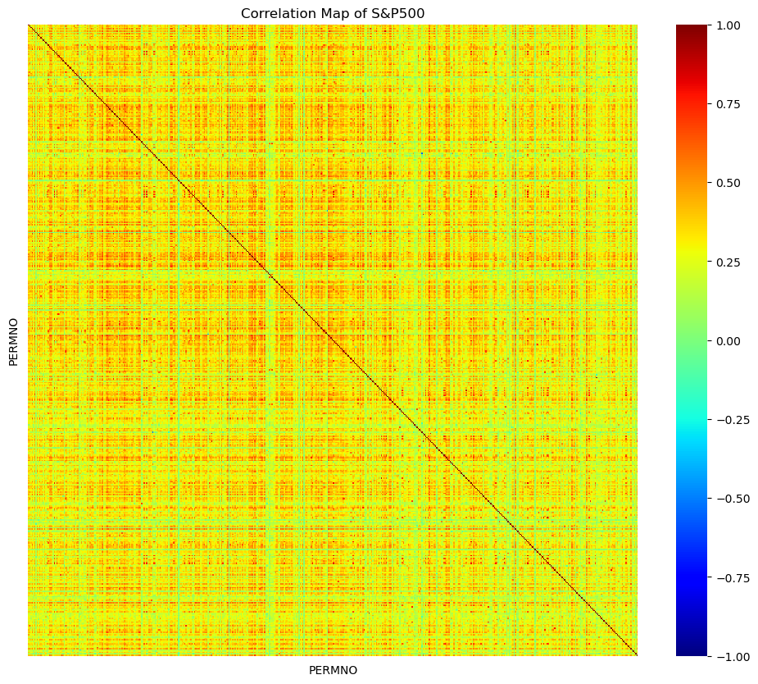
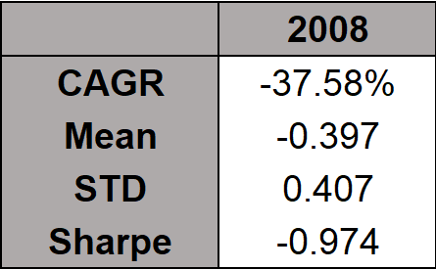
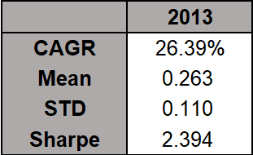
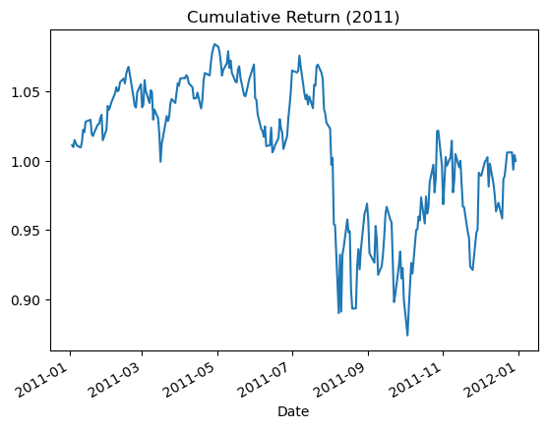
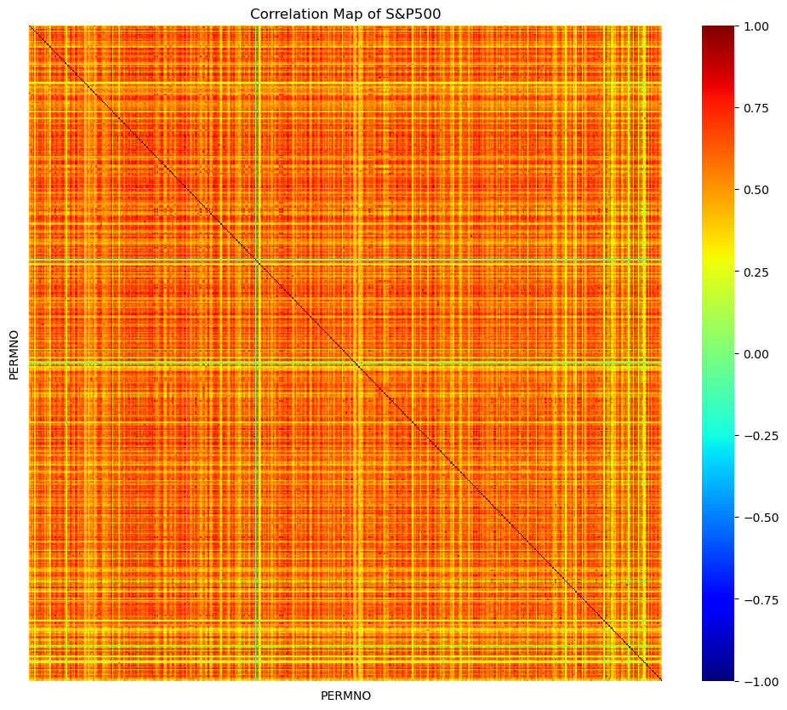
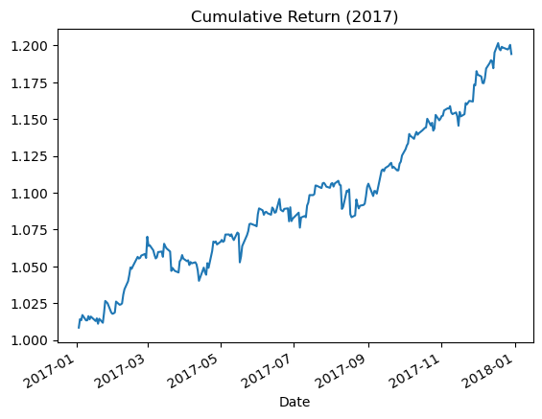
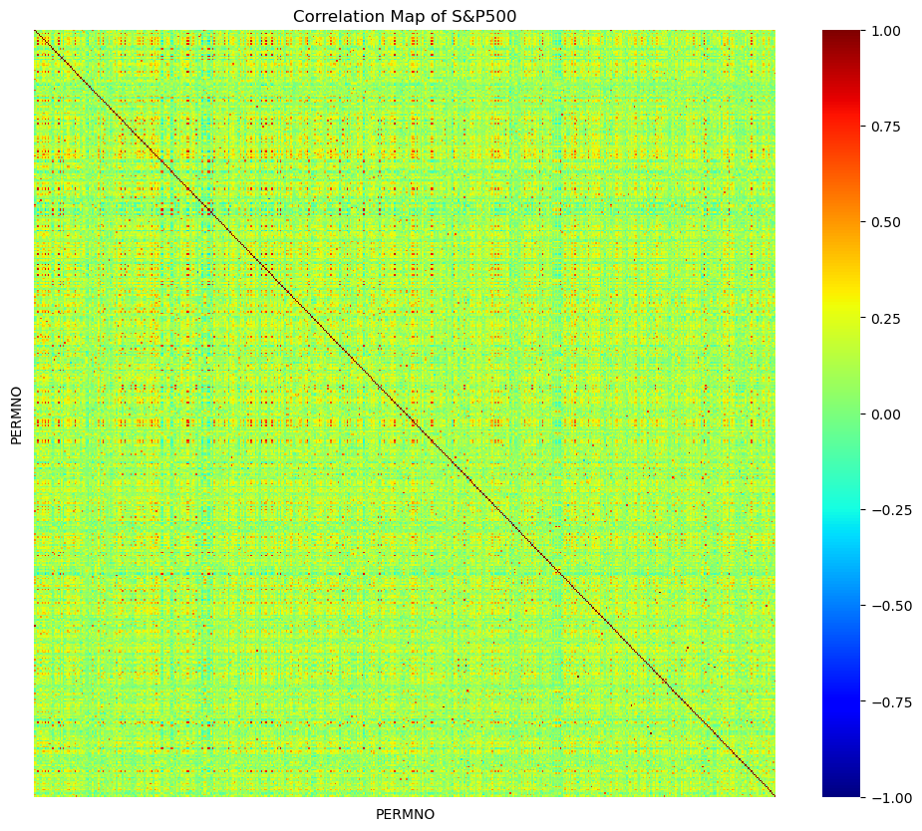
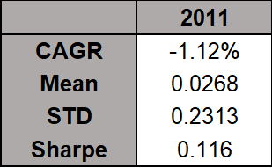
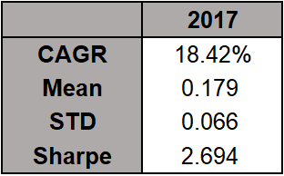
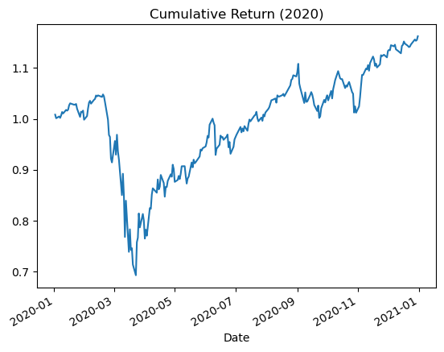
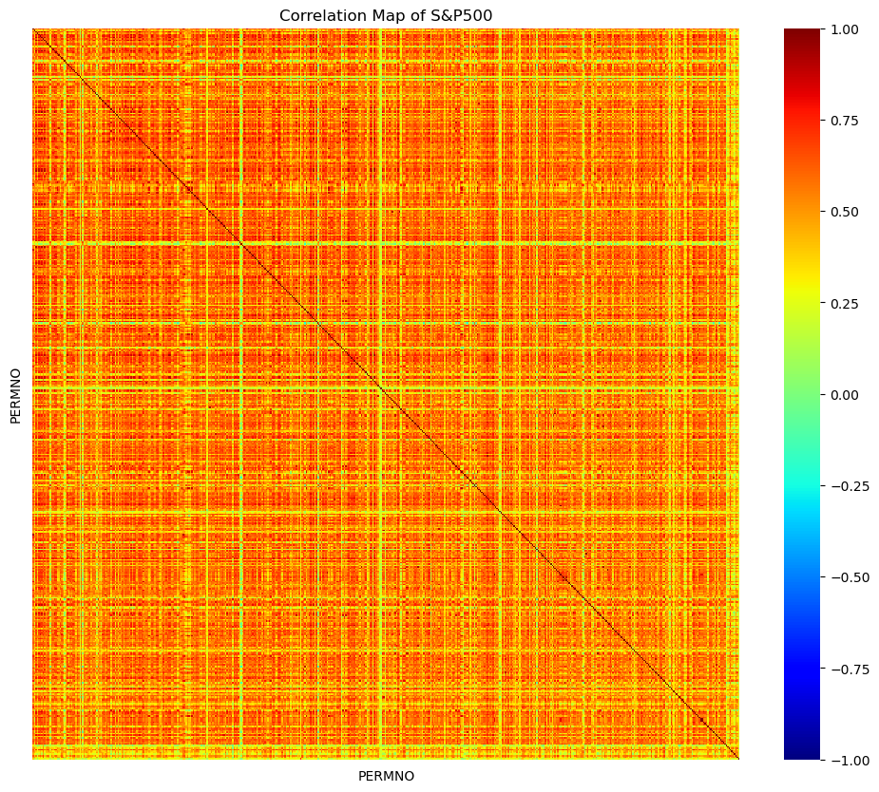
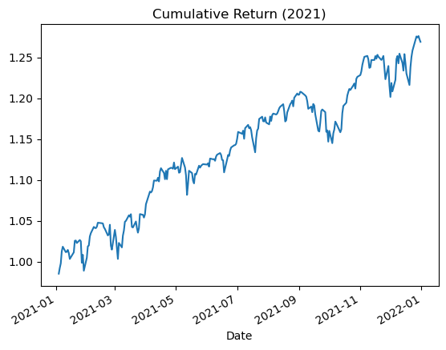
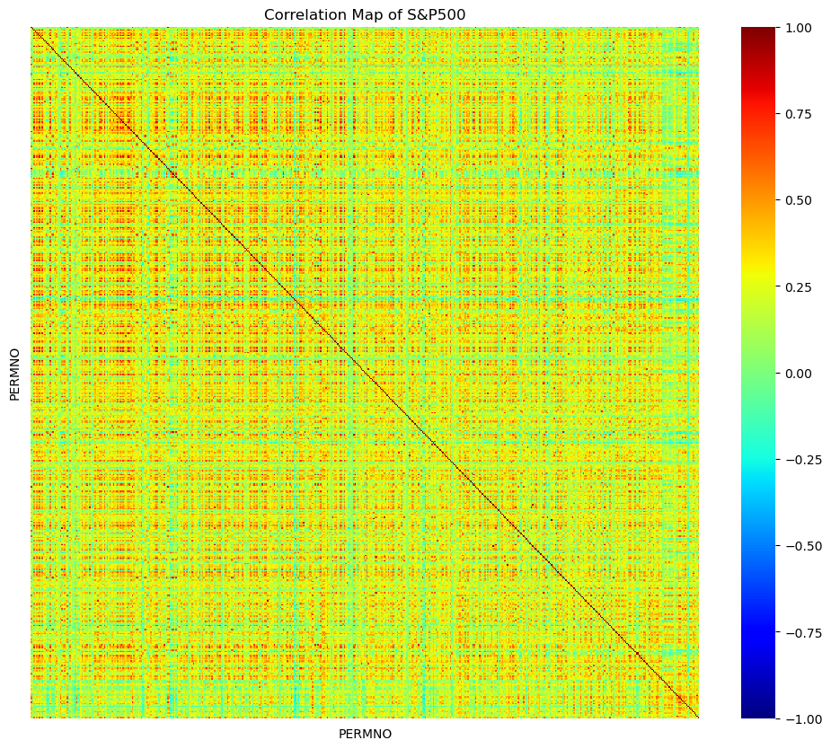
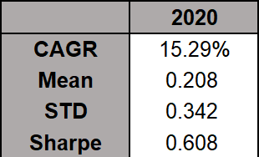
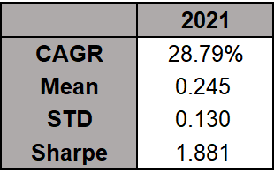
Ⅲ. Estimation Issues - Problem 2. Singular Covariance Matrix
Market Crash
Market Boom

Slide 14
Ⅳ. Empirical Result
Ⅰ. SLSQP - S&P500
Ⅱ. SLSQP - ETFs
Ⅲ. Assets Correlation
Ⅳ. Deep Learning - ETFs

Slide 15
Ⅳ. Empirical Result : SLSQP - S&P500
∙ Target: Sharpe Ratio Maximization / Variance Minimization
∙ Quarterly Rebalancing (End day of every quarter)
∙ Fee Rate : 15bp (For sell and buy)
∙ Hyper-parameter :
1. Look Back Window Size
2. Max Ratio of Each Assets
3. Shrinkage Method
(4). Argument of Shrinkage Method
Look Back Window Size
Shrinkage Method
90 Days
150 Days
210 Days
Basic Linear Shrinkage
Constant Shrinkage
Eigenvalue Clipping
Rebalancing Date

Slide 16
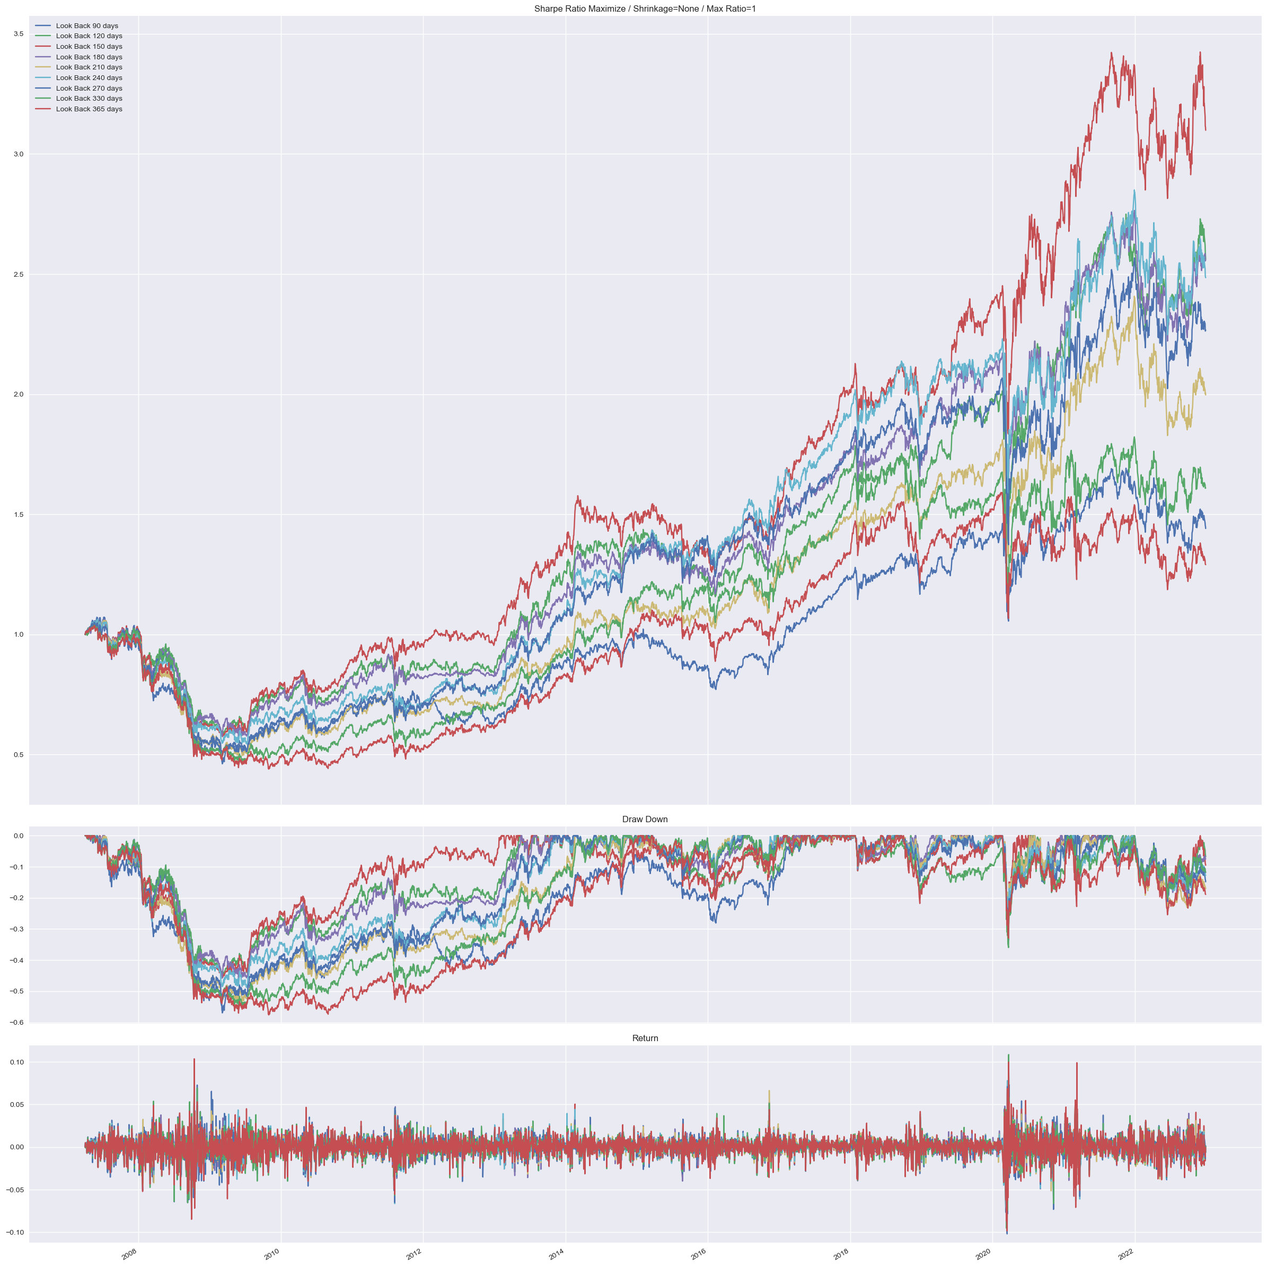
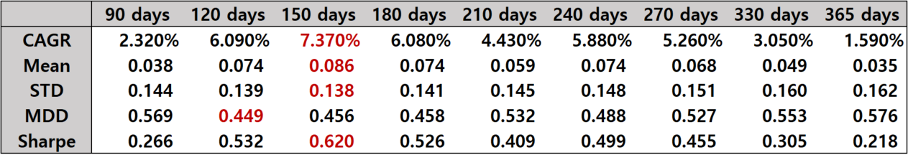
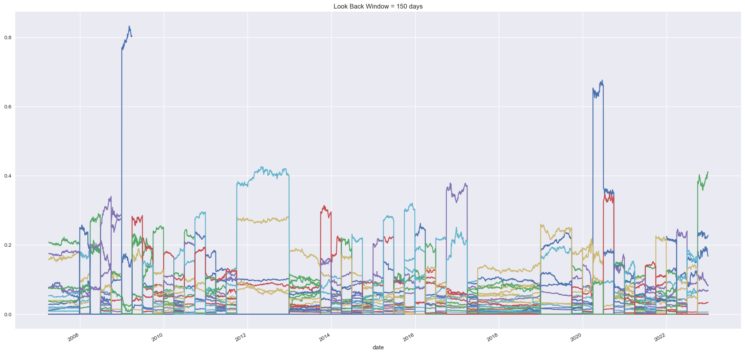
Ⅳ. Empirical Result : SLSQP - S&P500 / Sharpe Ratio Maximization
∙ Sharpe Ratio Maximization / No Shrinkage
Find Effect of Look Back Size
3.5
0.8
Weight (Look Back 150 Days)

Slide 17
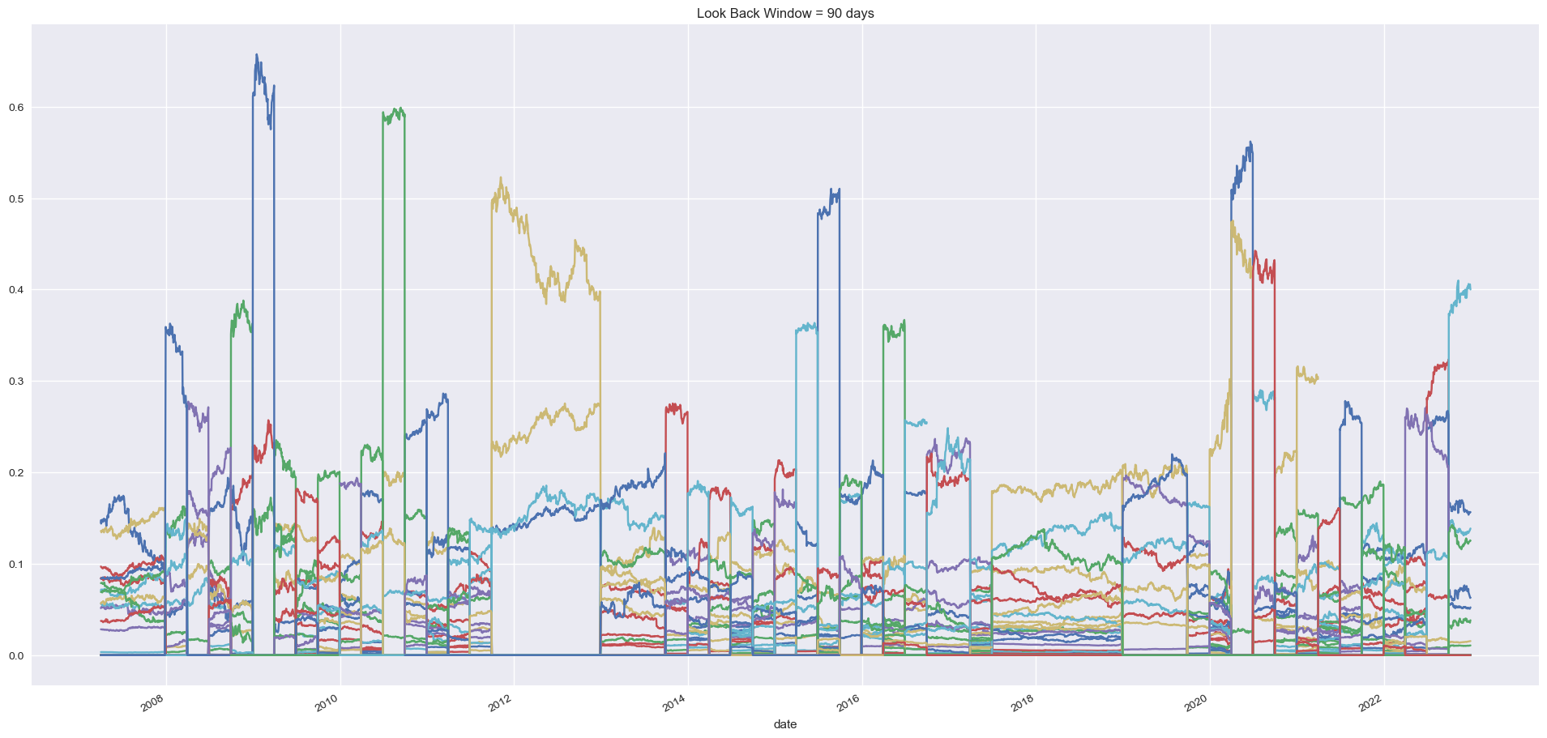
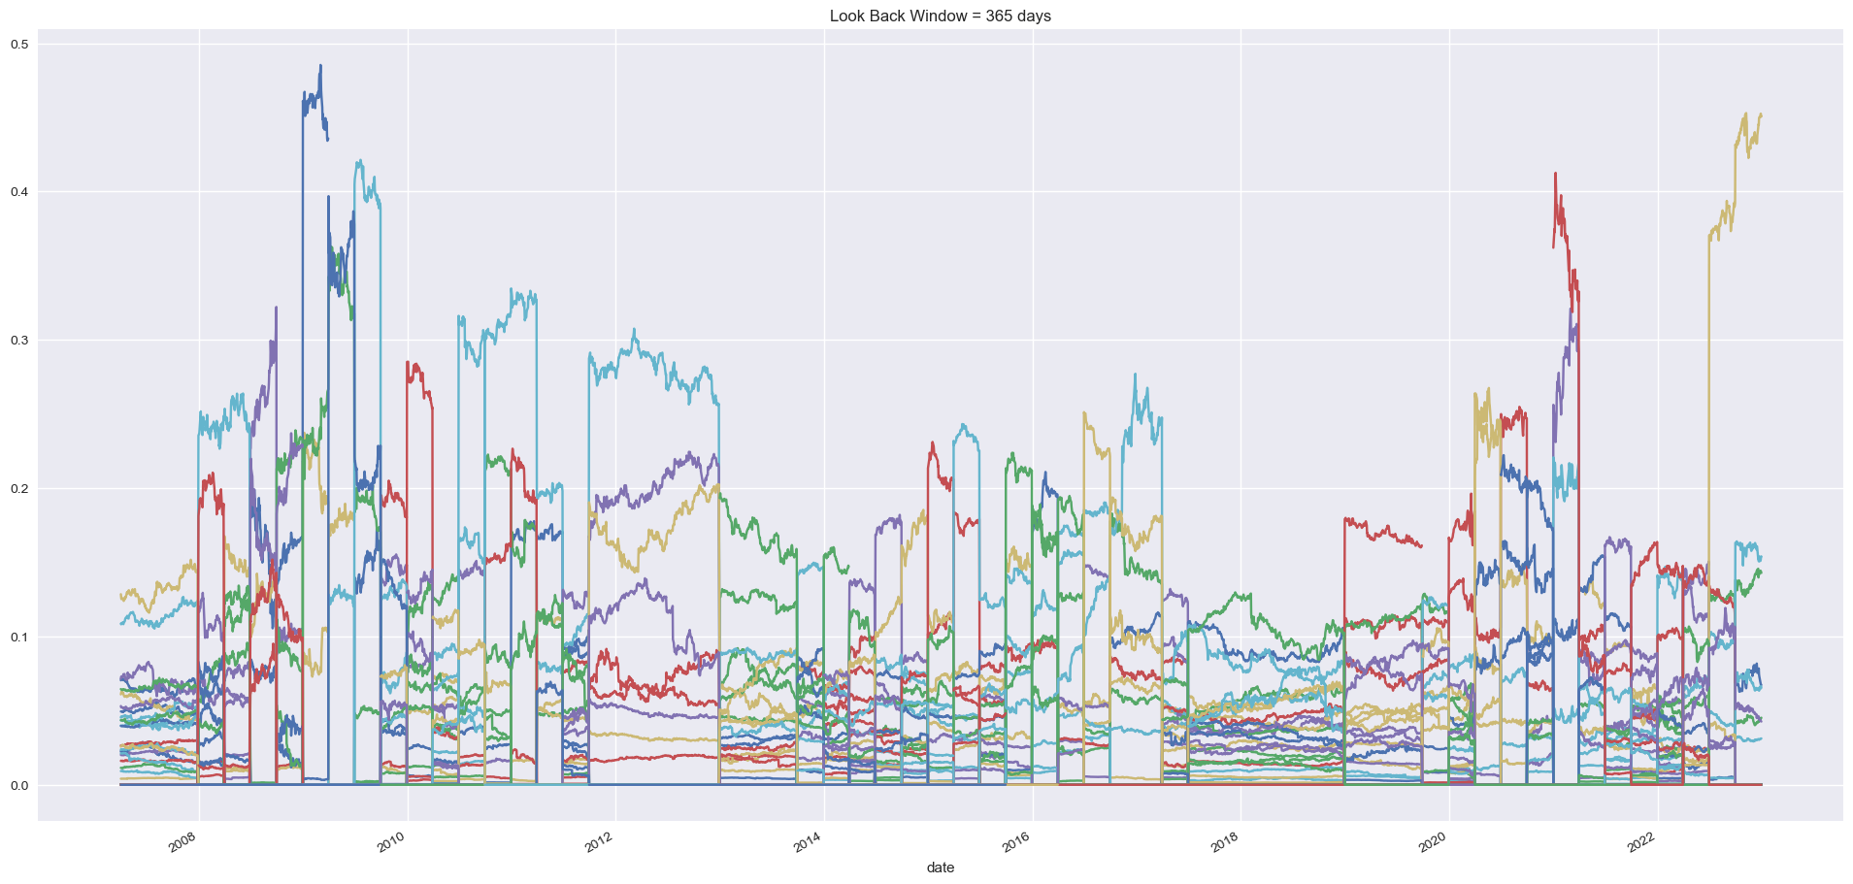
Ⅳ. Empirical Result : SLSQP - S&P500 / Sharpe Ratio Maximization
∙ Sharpe Ratio Maximization / No Shrinkage
∙ What We Need is Diversified Portfolio. Let’s See Weight Distribution
Find Effect of Look Back Size
0.6
0.6
0.5
Weight (Look Back 90 Days)
Weight (Look Back 150 Days)
Weight (Look Back 365 Days)
∙ Longer Look Back Window Make Portfolio Diversified
∙ But, Sharpe Ratio Did Not Increase
∙ Estimate Expected Return For Sharpe Ratio Object Function
More Estimate Error and Momentum Effect

Slide 18
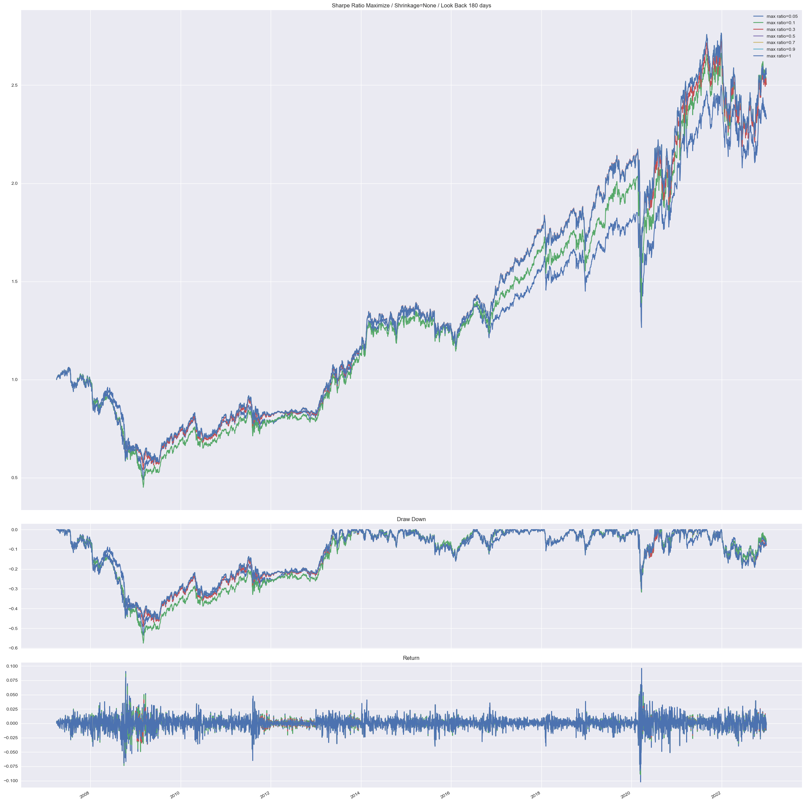
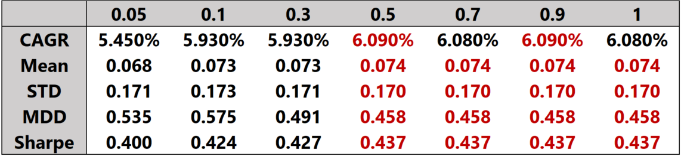
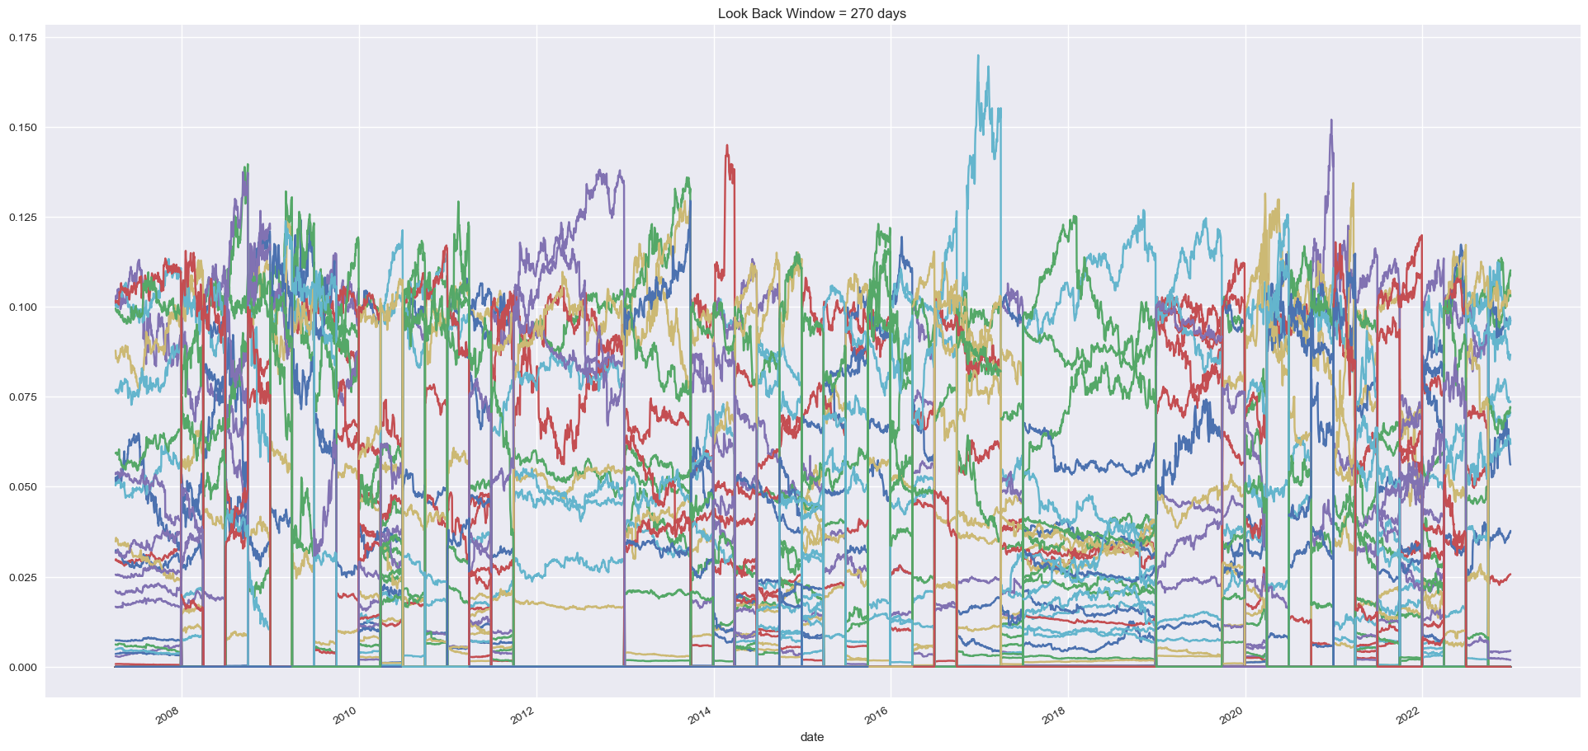
Ⅳ. Empirical Result : SLSQP - S&P500 / Sharpe Ratio Maximization
∙ Sharpe Ratio Maximization / No Shrinkage
Find Effect of Max Ratio (Fix Look Back Size : 150 Days)
Max Ratio
2.5
0.175
Weight (Max Ratio 0.1)
∙ Reduce The Max Ratio is Not a Good Option

Slide 19
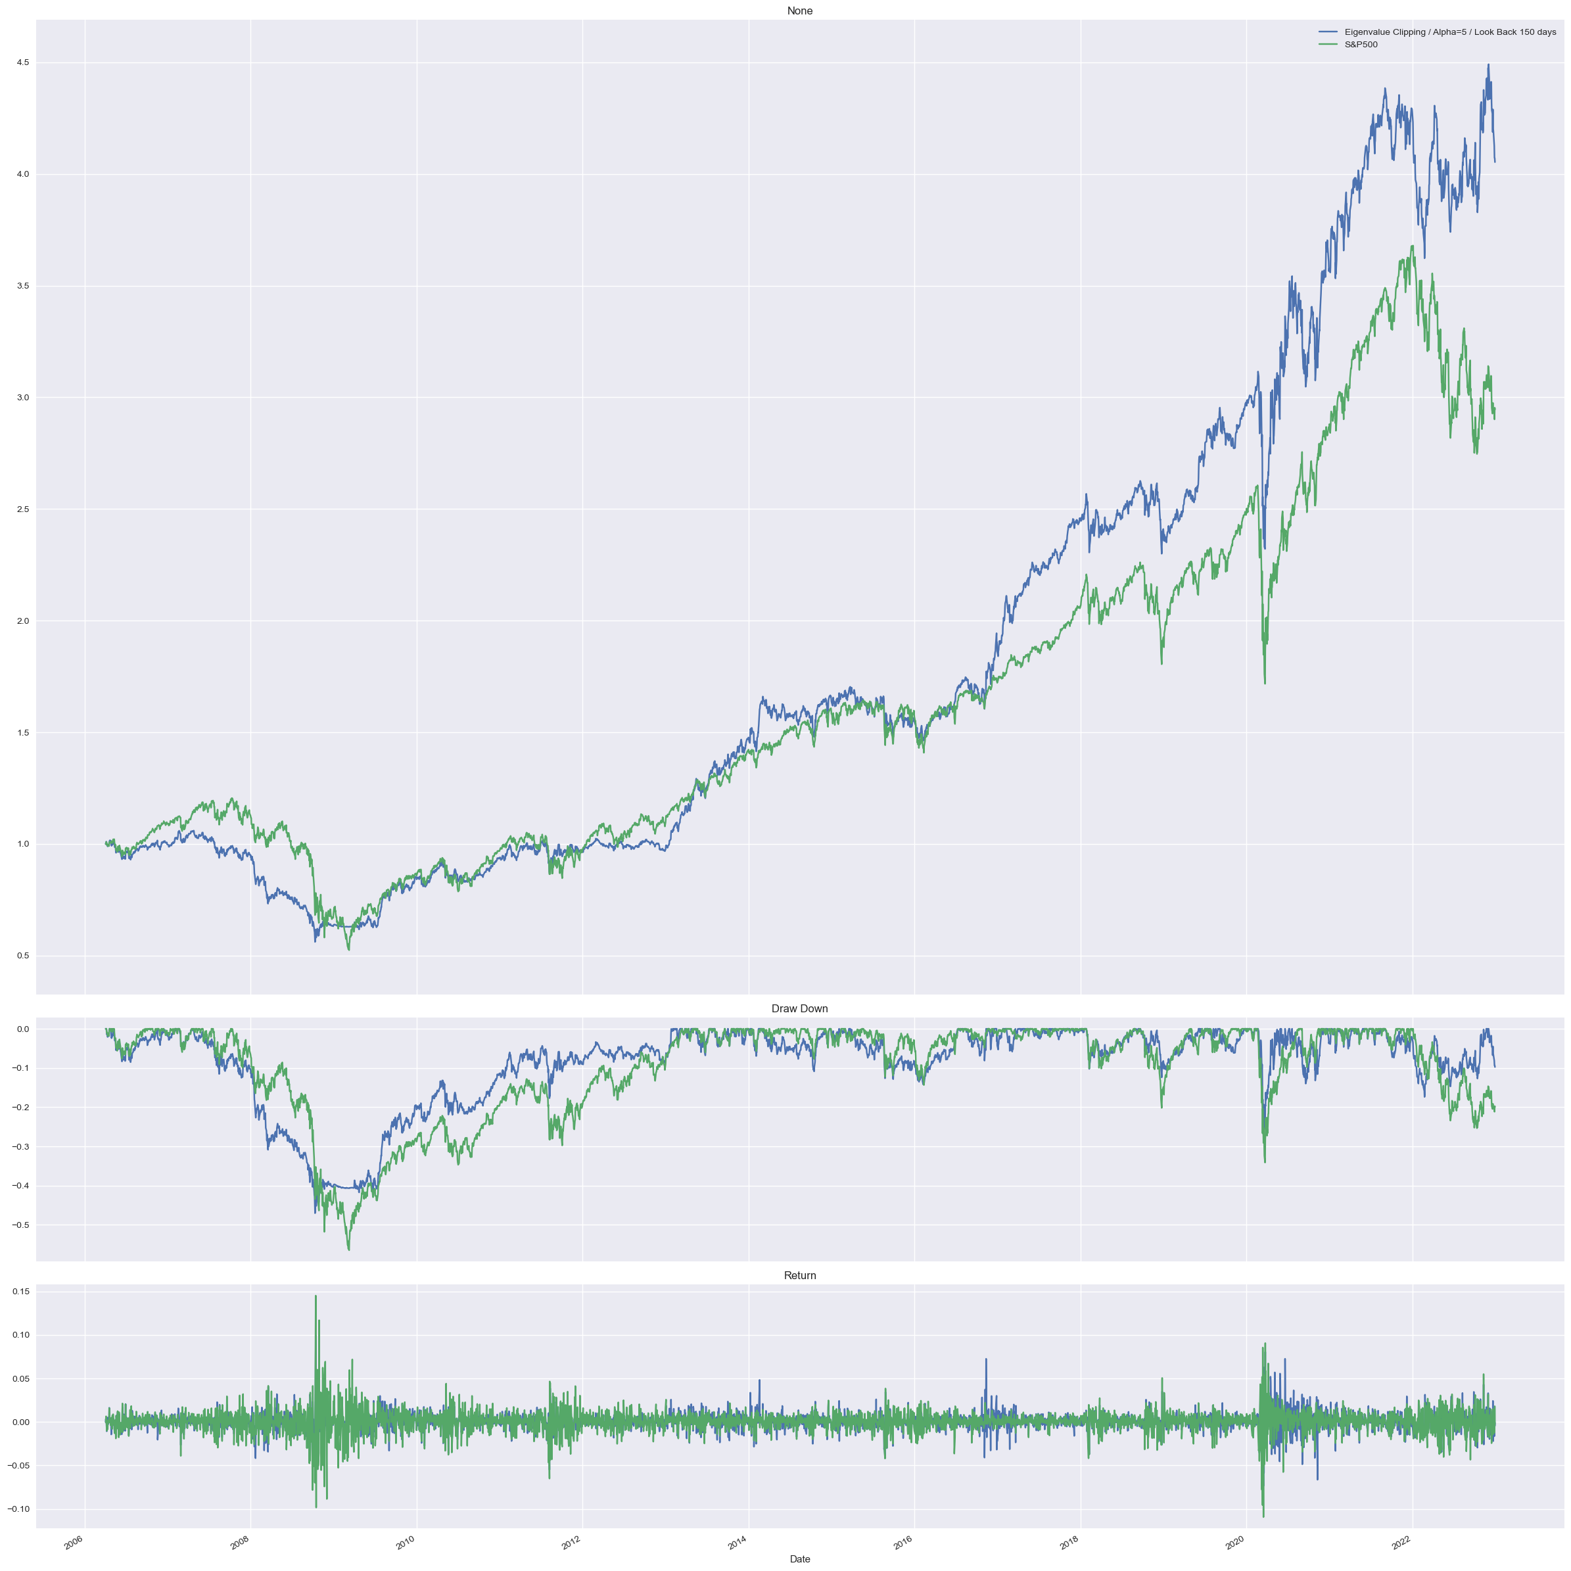
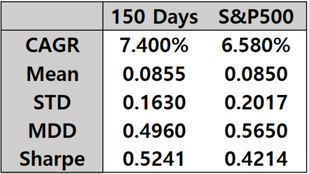
Ⅳ. Empirical Result : SLSQP - S&P500 / Sharpe Ratio Maximization
∙ Sharpe Ratio Maximization
Find Effect of Shrinkage Method (Fix Look Back Size : 150 Days)
∙ Average Sharpe Ratio : Constant < None < Linear < Eigenvalue Clipping
4.5
Clipping VS S&P500
T-Statistic : 1.39098
P-Value : 0.1903
∙ Eigenvalue Clipping is Good Option
∙ Sharpe Ratio Increase 0.1 by Eigenvalue Clipping
Compare to the Portfolio Without Shrinkage
∙ Constant Shrinkage Lose Too Much Information

Slide 20
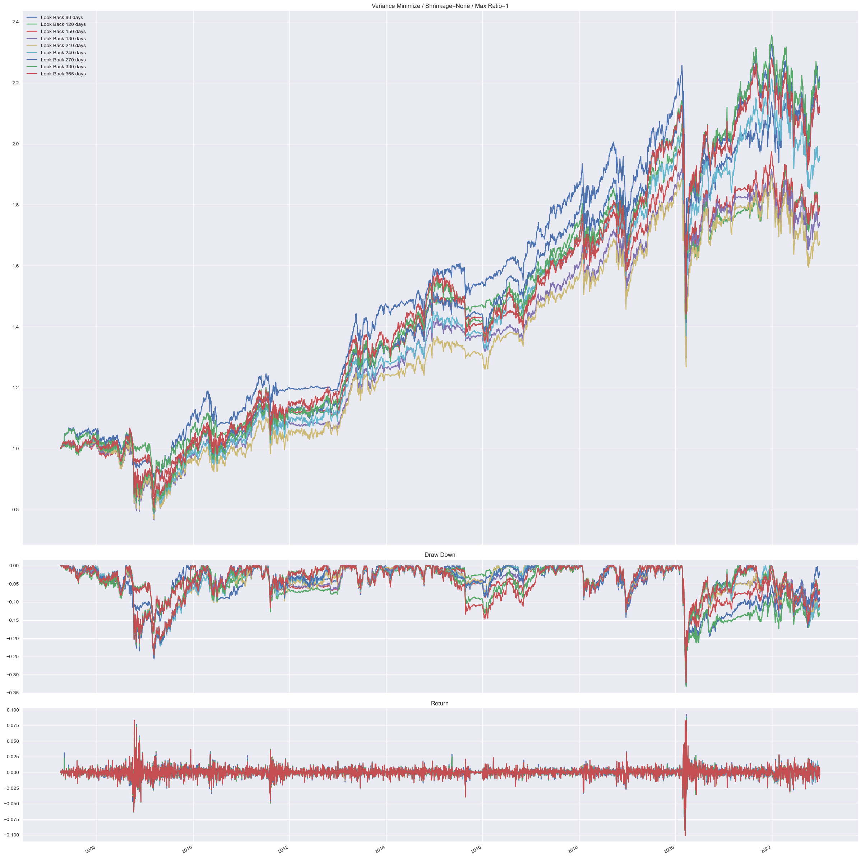
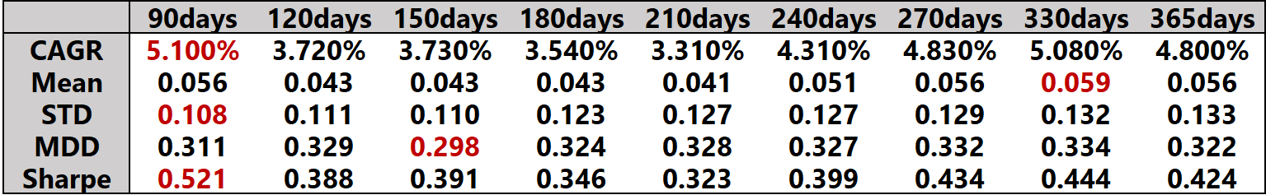
Ⅳ. Empirical Result : SLSQP - S&P500 / Variance Minimization
Find Effect of Look Back Size
∙ Variance Minimization / No Shrinkage
2.4
∙ Variance Minimization Result
∙ Sharpe Ratio Maximization (For Compare)
∙ Change of Sharpe Ratio is Relatively Small As Look Back
Window Change
∙ MDD is Relatively Small

Slide 21
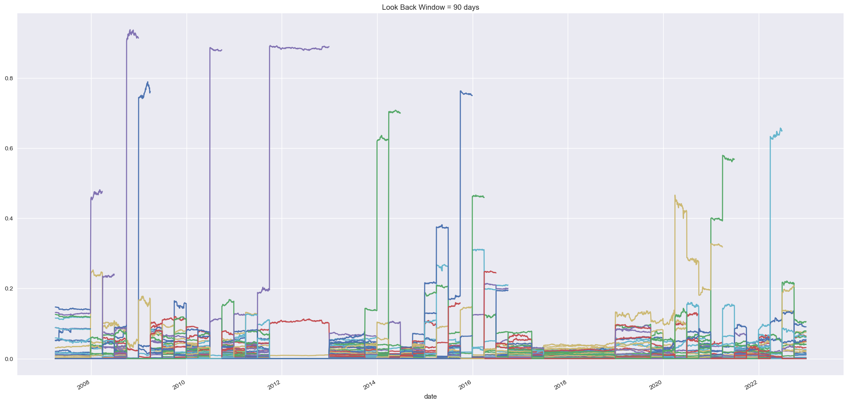
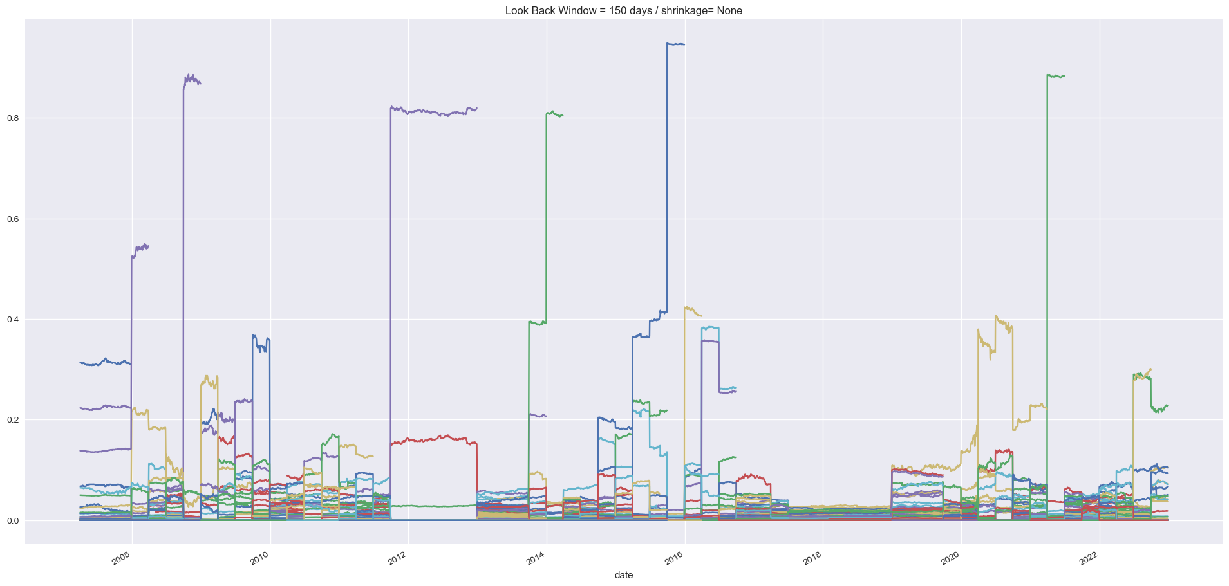
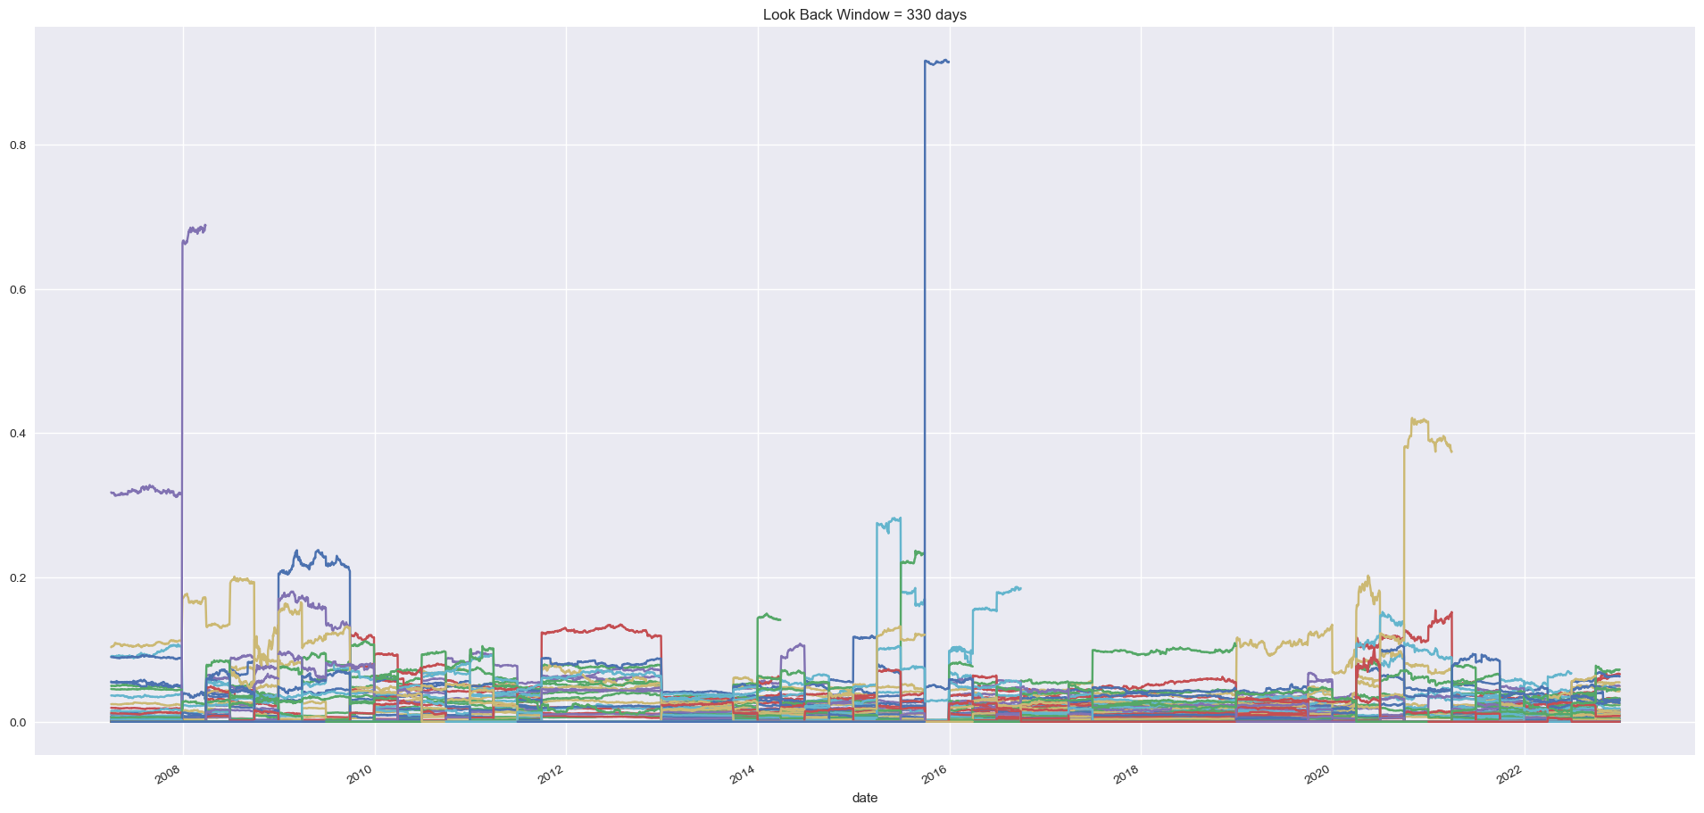
Ⅳ. Empirical Result : SLSQP - S&P500 / Variance Minimization
∙ Variance Minimization / No Shrinkage
∙ What We Need is Diversified Portfolio. Let’s See Weight Distribution
Find Effect of Look Back Size
0.8
0.8
0.8
Weight (Look Back 90 Days)
Weight (Look Back 150 Days)
Weight (Look Back 330 Days)
∙ Longer Look Back Window Make Portfolio Diversified
∙ More Diversified Portfolio Compare to Maximize Sharpe Ratio Portfolio
∙ In Terms of Variance Minimization, Longer Look Back Window Tend to Record High Sharpe Ratio

Slide 22
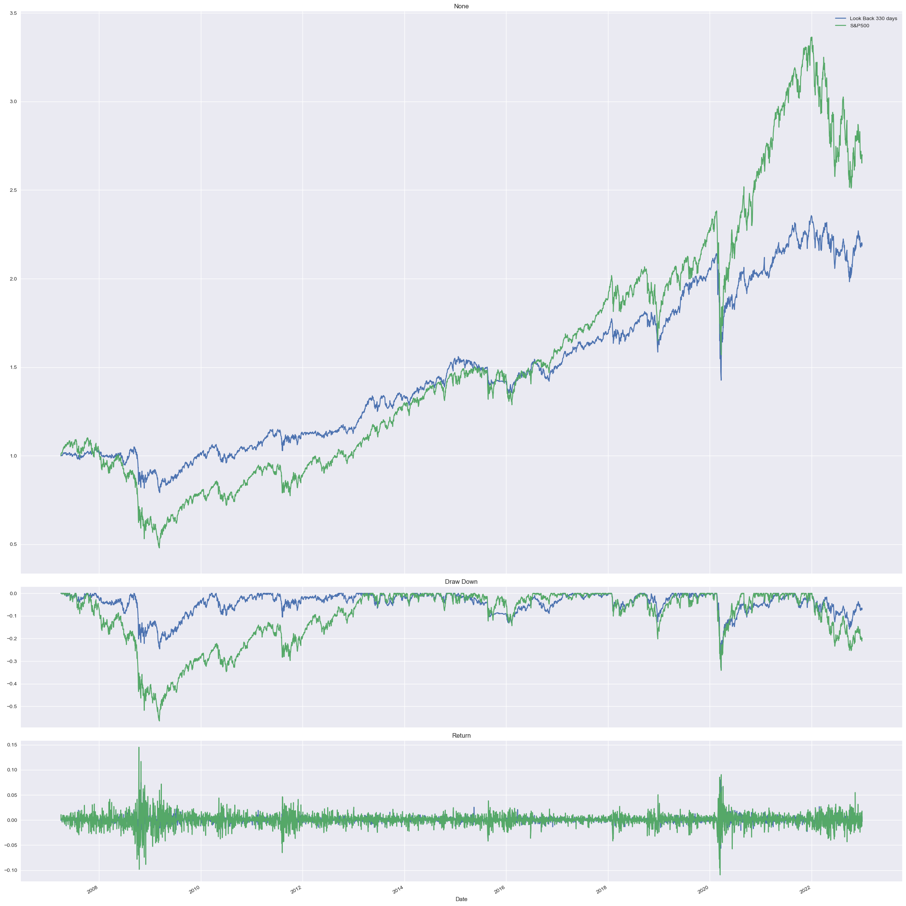
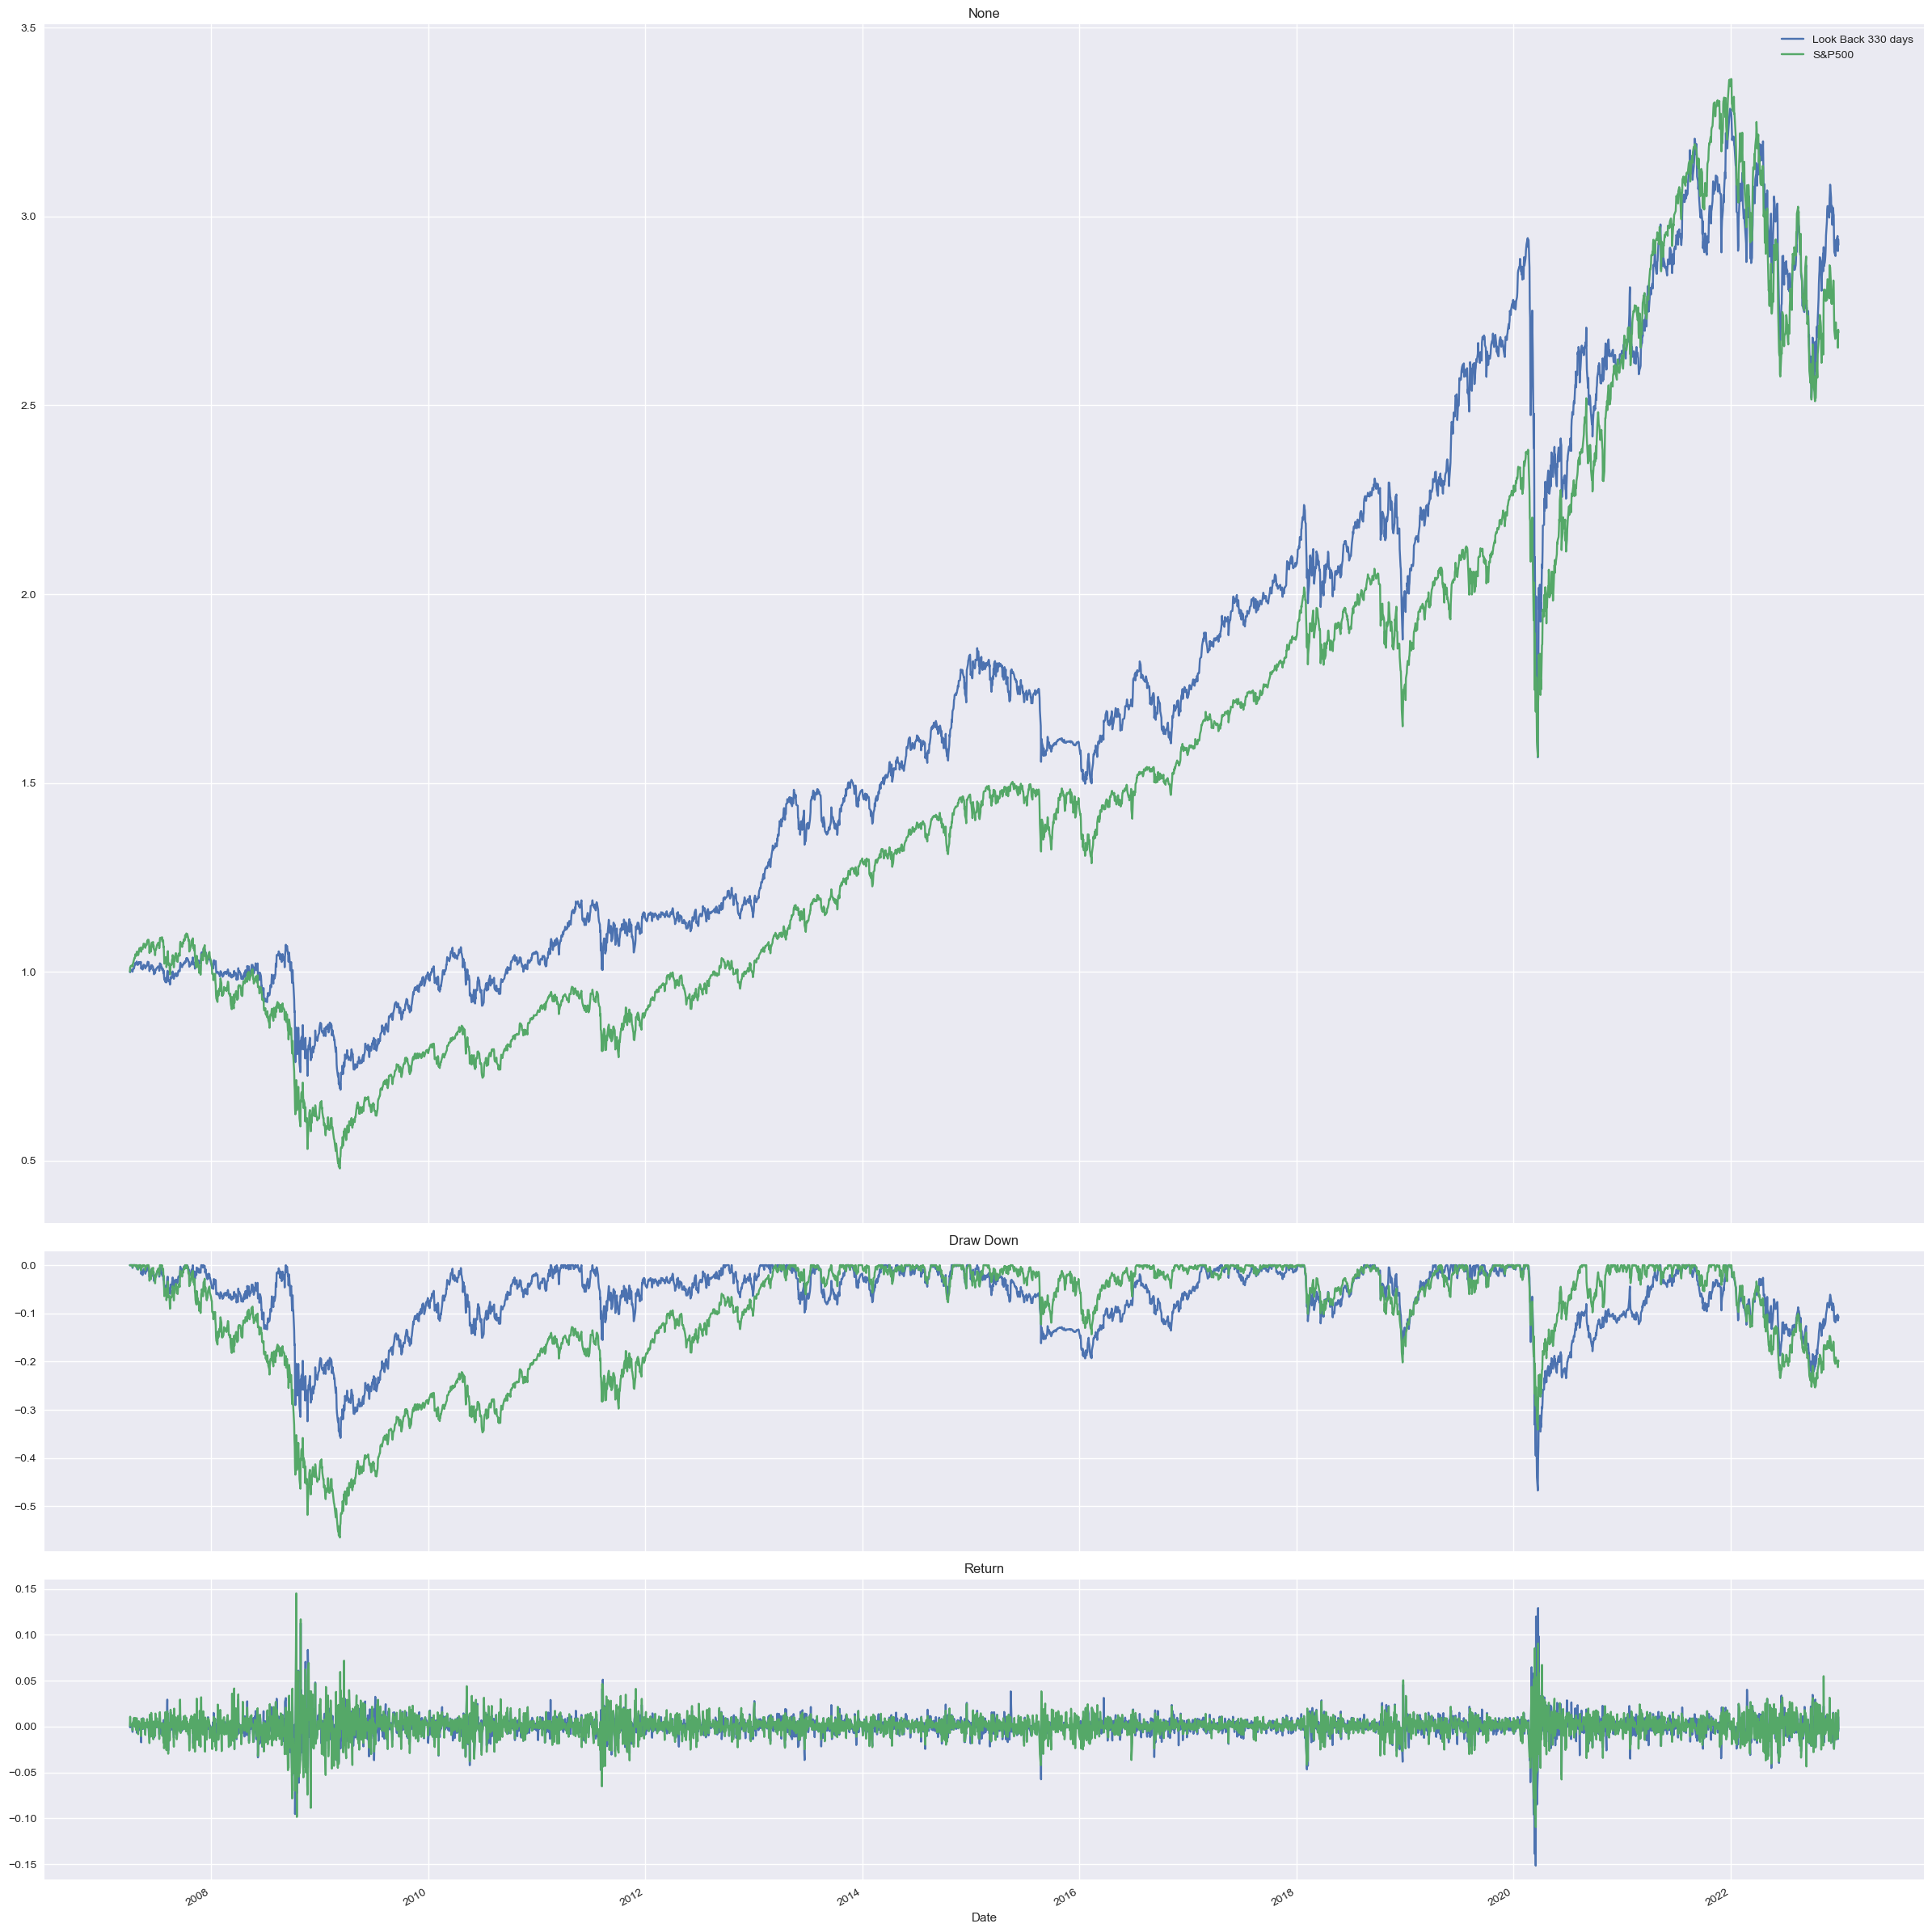
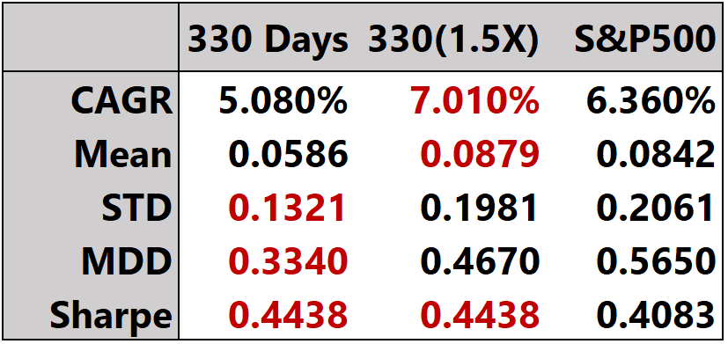
Ⅳ. Empirical Result : SLSQP - S&P500 / Variance Minimization
Find Effect of Leverage
∙ Variance Minimization / No Shrinkage
3.5
3.5
Look Back Window 330 Days VS S&P500
1.5X VS S&P500
T-Statistic : 0.7554
P-Value : 0.4501
∙ Use Leverage After Minimize Variance is Good Choice
∙ Lower Sharpe Ratio in Minimum Variance Portfolio With Leverage Compare to Maximize Sharpe Ratio
Portfolio (Look Back 150 days)

Slide 23
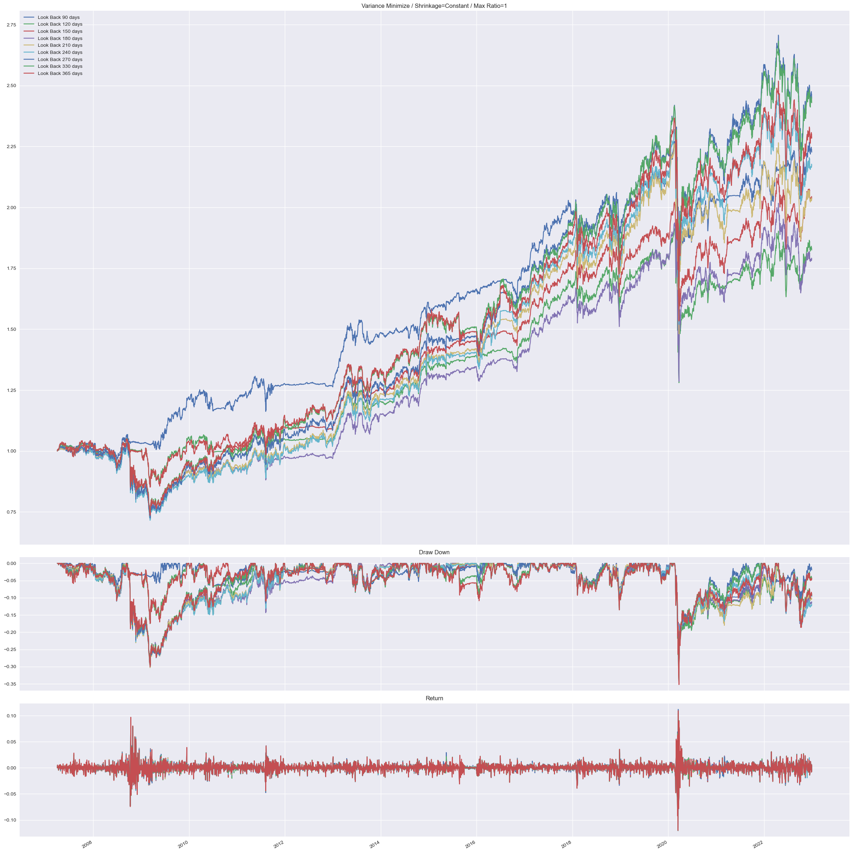
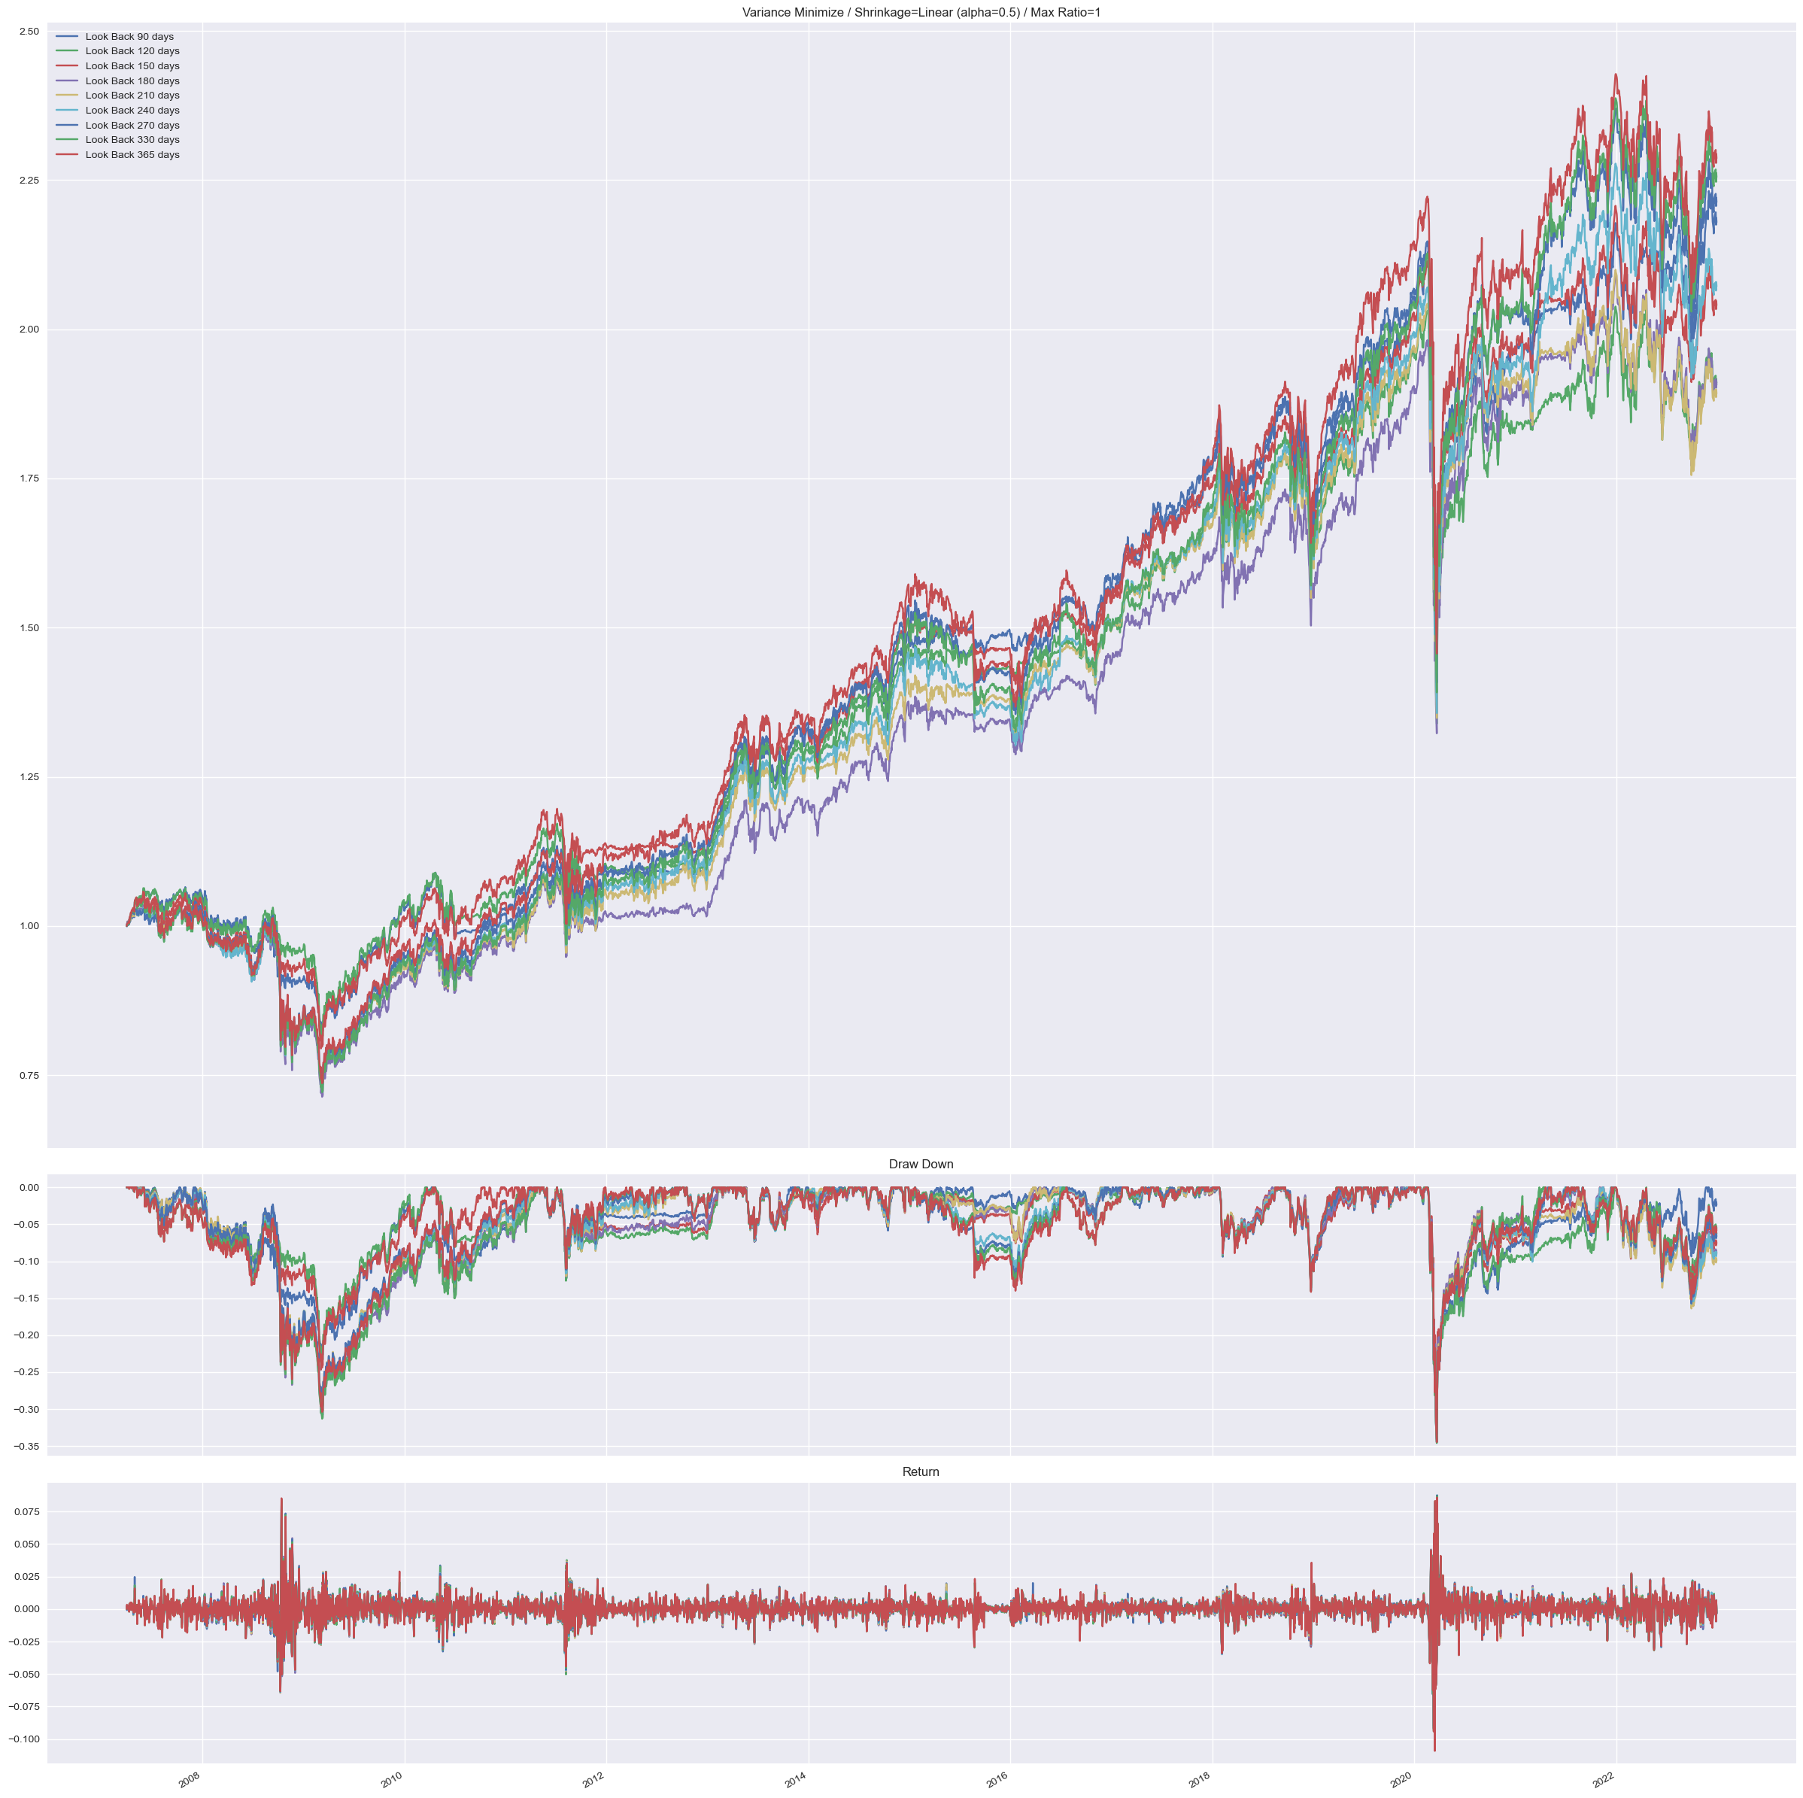
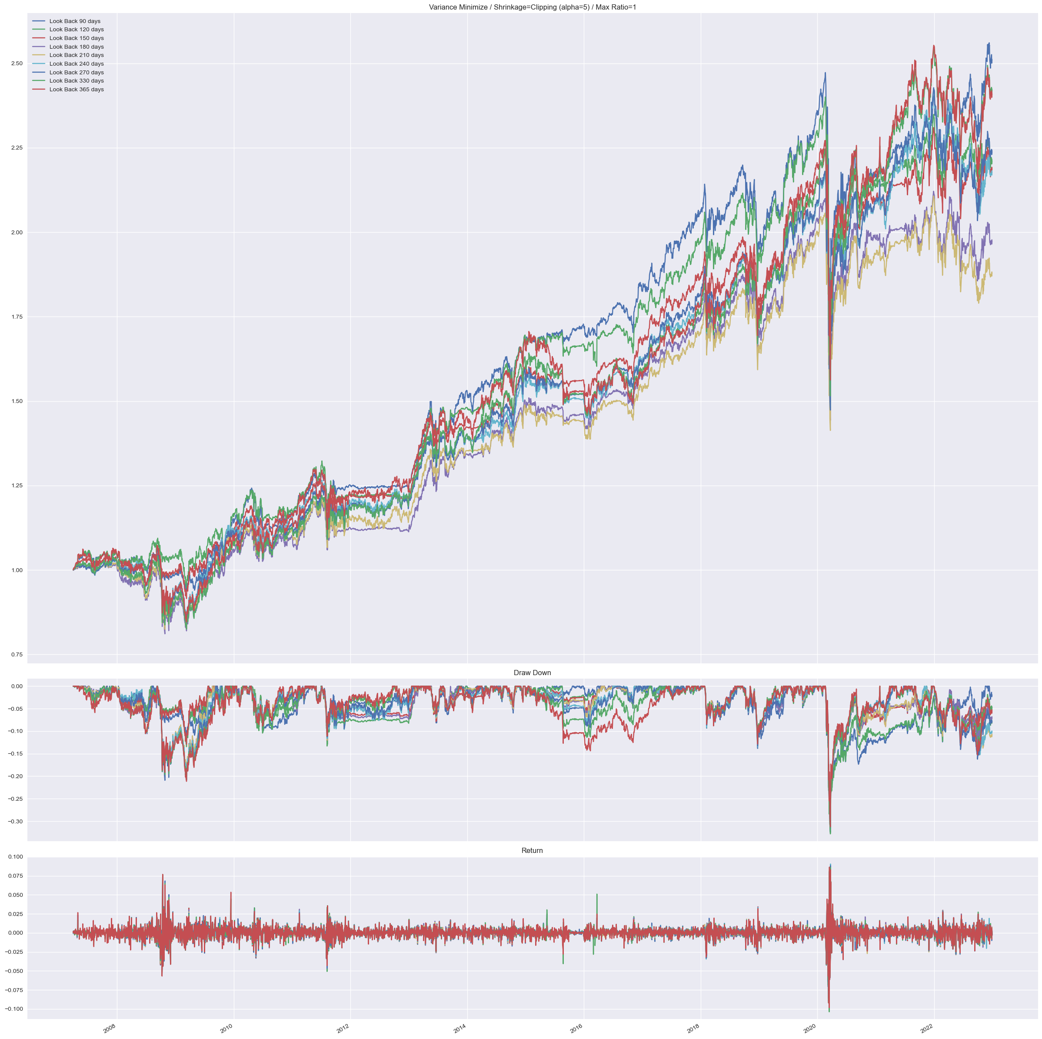
Ⅳ. Empirical Result : SLSQP - S&P500 / Variance Minimization
∙ Variance Minimization
Find Effect of Shrinkage Method
∙ Average Sharpe Ratio : None < Constant < Linear < Eigenvalue Clipping
2.75
2.5
2.5
Constant Shrinkage (alpha=0.5)
Linear Shrinkage (alpha=0.5)
Eigenvalue Clipping (k=5)

Slide 24
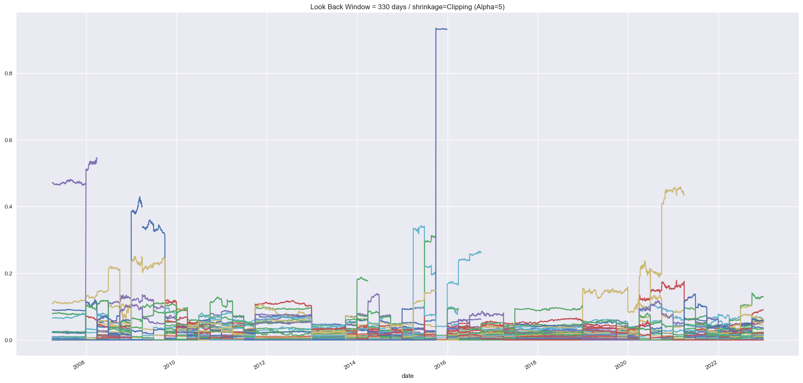
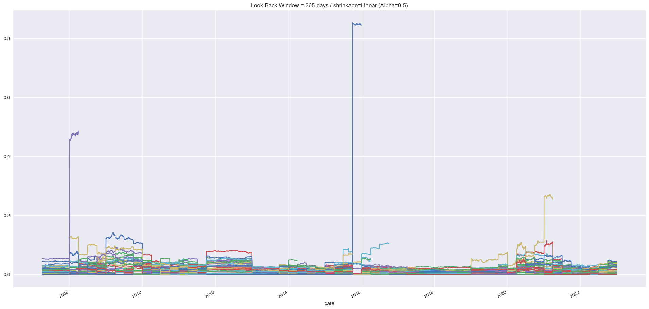
Ⅳ. Empirical Result : SLSQP - S&P500 / Variance Minimization
∙ Variance Minimization / Eigenvalue Clipping
∙ Average Sharpe Ratio : None < Constant < Linear < Eigenvalue Clipping
∙ Does Clipping Method Make Portfolio Diversified?
Find Effect of Shrinkage
0.8
0.8
0.8
None Shrinkage (Look Back 330 Days)
Linear Shrinkage (Look Back 330 Days)
Eigenvalue Clipping (Look Back 330 Days)

Slide 25



Ⅳ. Empirical Result : SLSQP - S&P500 / Variance Minimization
∙ Variance Minimization / Eigenvalue Clipping
Find Effect of Leverage
3.5
Look Back Window 330 Days VS S&P500
3.5
1.5X VS S&P500
∙ Use Leverage After Minimize Variance is Good Choice
∙ Sharpe Ratio Increase 0.5 by Eigenvalue Clipping Compare to Portfolio Without Shrinkage

Slide 26
Ⅳ. Empirical Result : SLSQP – S&P500
Findings
∙ Portfolio is Optimized, But Did Not Mean Much
∙ Shrinkage Method Quite Work Well

Slide 27
Ⅳ. Empirical Result
Ⅰ. SLSQP - S&P500
Ⅱ. SLSQP - ETFs
Ⅲ. Assets Correlation
Ⅳ. Deep Learning - ETFs

Slide 28



Ⅳ. Empirical Result : SLSQP - ETFs / Sharpe Ratio Maximization
∙ Sharpe Ratio Maximization / No Shrinkage
Find Effect of Look Back Size
1.6
1.0
Weight (Look Back 500 Days)

Slide 29


Ⅳ. Empirical Result : SLSQP - ETFs / Sharpe Ratio Maximization
Findings
∙ Longer Look Back Window Tend to Give Higher Sharpe Ratio Market Regime?
∙ Extreme Corner Solution
∙ When the Number of Assets is Small, Shrinkage Method Do Not Work Well
∙ Alternatively, Max Ratio Regularization is Good Option. On Average,
Sharpe Ratio Increase More Than 0.2 (Max Ratio=0.2).
∙ Max Ratio Regularization Give Even Lower MDD.
Max Ratio 0.2
Max Ratio 0.2 : Statistic

Slide 30
Ⅳ. Empirical Result : SLSQP - ETFs / Sharpe Ratio Maximization
∙ Sharpe Ratio Maximization / No Shrinkage
Find The Best Portfolio
∙ Drop the Highly Correlated Assets (VNQ, SHY, BIL)
∙ Do Monthly Rebalancing (Rebalancing Every End of Month) / Considering Fee (15bp)
∙ Max Ratio Regularization

Slide 31



Ⅳ. Empirical Result : SLSQP - ETFs / Sharpe Ratio Maximization
∙ Sharpe Ratio Maximization / No Shrinkage
Find The Best Portfolio
5.0
3.5
Max Ratio = 0.2
Monthly Rebalancing
Look Back 600 Days

Slide 32
Ⅳ. Empirical Result : SLSQP - ETFs / Sharpe Ratio Maximization
Findings
∙ Variance Minimization Portfolio in Case of Various Assets Groups Give Too Low Returns and Sharpe Ratio
∙ Assets Selection is Very Important (Drop Some Highly Correlated Assets)

Slide 33
Ⅳ. Empirical Result
Ⅰ. SLSQP - S&P500
Ⅱ. SLSQP - ETFs
Ⅲ. Assets Correlation
Ⅳ. Deep Learning - ETFs

Slide 34

Ⅳ. Empirical Result : Rolling Correlation of ETFs
Ticker
SPY : S&P500
BIL : 1~3M Bond
SHY : 1~3Y Bond
TLT : 20Y+ Bond
GLD : Gold
GSG : Commodity
DBA : Agriculture
VNQ : Real Estate
Note) Window Size : 6 Month

Slide 35

Ⅳ. Empirical Result : Rolling Correlation of ETFs – Remark (With Stock)
Ticker
SPY : S&P500
BIL : 1~3M Bond
SHY : 1~3Y Bond
TLT : 20Y+ Bond
GLD : Gold
GSG : Commodity
DBA : Agriculture
VNQ : Real Estate
Note) Window Size : 6 Month

Slide 36

Ⅳ. Empirical Result : Rolling Correlation of ETFs – Remark (With Bond)
Ticker
BIL : 1~3M Bond
SHY : 1~3Y Bond
TLT : 20Y+ Bond
GLD : Gold
GSG : Commodity
Note) Window Size : 6 Month

Slide 37
Ⅳ. Empirical Result
Ⅰ. SLSQP - S&P500
Ⅱ. SLSQP - ETFs
Ⅲ. Assets Correlation
Ⅳ. Deep Learning - ETFs

Slide 38
V. LSTM
data
LSTM
weight

Slide 39
V. LSTM - Hyperparameter
Number of Hidden Layers
Epoch
Look Back Window
Number of Nodes
Hyperparameter

Slide 40
V. LSTM - Hyperparameter
“hidden_layers”:[1 , 2 , 3]
1: just approximation, but good for small data sets
2,3 : better for more complex data, but prone to overfitting when data is small
Number of Hidden Layers
Epoch
Look Back Window
Number of Nodes
Hyperparameter
"epochs":[3, 6, 9, 12, 15]
15<=:overfitting Issue(Overweight on few assets)
"nodes" :[16, 32, 64, 80, 96, 112, 128]
Considering only even numbers based on the size of the data
Try to manage underfitting and overfitting
"lookbackwindow":[200,300,400,500]
<200 : not significant(MA=240 고려)
400, 500< : Generally High Sharpe Ratio

Slide 41

V. LSTM - Hyperparameter Tuning
"hidden_layers":[1,2,3],
"epochs":[3, 6, 9, 12, 15],
"nodes" :[16, 32, 64, 80, 96, 112, 128],
"lookbackwindow":[200,300,400,500]

Slide 42

VI. Result Analysis Method
3D plot
(https://colab.research.google.com/drive/1t1dxDko6Xqd93wEKbP7gQMxNHRu9c1sp)

Slide 43

VII. Nodes VS Hidden Layer
Nodes :
In each Hidden Layer
Hidden Layers :
Layers that exist between input layer and output layer affect the depth of LSTM

Slide 44


VIII. Returns with Quantstrat - 1
“hidden_layers”:1, “Epochs”:6,
“nodes”:112, “lookback”:500

Slide 45


VIII. Returns with Quantstrat - 2
“hidden_layers”:1, “Epochs”:6,
“nodes”:32, “lookback”:500

Slide 46


VIII. Returns with Quantstrat - 3
“hidden_layers”:3, “Epochs”:9,
“nodes”:128, “lookback”:500

Slide 47


VIII. Returns with Quantstrat - 4
“hidden_layers”:3, “Epochs”:12,
“nodes”:80, “lookback”:500

Slide 48

IX. Selected Result - Strategy 1
“hidden_layers”:1,
“Epochs”:6,
“nodes”:112,
“lookback”:500
Cumulative Return 138.09%
CAGR﹪ 5.92%
Sharpe 0.51
Prob. Sharpe Ratio 97.65%
Expected Daily % 0.02%
Expected Monthly % 0.48%
Expected Yearly % 5.57%
Best Day 8.28%
Worst Day -6.93%
Best Month 18.84%
Worst Month -15.32%
Best Year 33.19%
Worst Year -13.09%
Win Days % 53.37%
Win Month % 58.24%
Win Quarter % 65.57%
Win Year % 68.75%
Max Drawdown -31.98%
Longest DD Days 891
Volatility (ann.) 12.86%
Calmar 0.18
Skew 0.05
Kurtosis 11.53

Slide 49


IX. Selected Result - Strategy 1
“hidden_layers”:1,
“Epochs”:6,
“nodes”:112,
“lookback”:500
Cumulative Return 138.09%
CAGR﹪ 5.92%
Sharpe 0.51
Prob. Sharpe Ratio 97.65%
Expected Daily % 0.02%
Expected Monthly % 0.48%
Expected Yearly % 5.57%
Best Day 8.28%
Worst Day -6.93%
Best Month 18.84%
Worst Month -15.32%
Best Year 33.19%
Worst Year -13.09%
Win Days % 53.37%
Win Month % 58.24%
Win Quarter % 65.57%
Win Year % 68.75%
Max Drawdown -31.98%
Longest DD Days 891
Volatility (ann.) 12.86%
Calmar 0.18
Skew 0.05
Kurtosis 11.53

Slide 50
X. Citation
S. Begušić and Z. Kostanjčar, "Cluster-Based Shrinkage of Correlation Matrices for Portfolio Optimization," 2019 11th International Symposium on Image and Signal Processing and Analysis (ISPA), Dubrovnik, Croatia, 2019, pp. 301-305, doi: 10.1109/ISPA.2019.8868482.
Zihao Zhang and Stefan Zohren and Stephen Roberts, “Deep Learning for Portfolio Optimization,” The Journal of Financial Data Science, 2020, vol. 2 no. 4 pp. 8-20, https://doi.org/10.3905/jfds.2020.1.042
Markowitz, Harry. “Portfolio Selection.” The Journal of Finance 7, no. 1 (1952): 77–91. https://doi.org/10.2307/2975974.
Sébastien Page & Robert A. Panariello (2018) When Diversification Fails, Financial Analysts Journal, 74:3, 19-32,
DOI: 10.2469/faj.v74.n3.3
Marcos M. López de Prado (2020), Machine Learning for Asset Managers, Cambridge University Press
Matthew F. Dixon, Igor Halperin, Paul Bilokon (2020), Machine Learning in Finance: From Theory to Practice, Springer

Slide 51
X. Citation
Stefan Jansen (2020), Machine Learning for Algorithmic Trading: Predictive models to extract signals from market and alternative data for systematic trading strategies with Python, Packt Publishing
Stefan Jansen (2018), Hands-On Machine Learning for Algorithmic Trading, Packt Publishing
Hyemee Kim, Ryeji Jeong, Hyerim Bae.(2019).Hyper Parameter Tuning Method based on Sampling for Optimal LSTM Model.한국컴퓨터정보학회논문지 ,24(1),137-143.
김태헌, 신준호 (2020), (퀀트 전략을 위한) 인공지능 트레이딩 : 파이썬과 케라스를 활용한 머신러닝/딥러닝 퀸트 전략 기술, 한빛미디어

Slide 52
Thank you

